Slide 1
General and Molecular Biology
Translation
By: Shozab Seemab Khan (PhD Scholar)

Slide 2
5’-ATGCCTAGGTACCTATGA-3’
3’-TACGGATCCATGGATACT-5’’
DNA
DNA Replication
5’-ATGCCTAGGTACCTATGA-3’
3’-TACGGATCCATGGATACT-5’’
5’-ATGCCTAGGTACCTATGA-3’
3’-TACGGATCCATGGATACT-5’’
Transcription
mRNA
5’-AUGCCUAGGUACCUAUGA-3’
Decoded as
Genetic Codes (Codons)
5’-AUG CCU AGG UAC CUA UGA-3’’
Translation
Amino Acids linked
by Peptide Bond
MET—PRO—ARG—TYR—LEU
Polypeptide chain
Protein
CENTRAL DOGMA

Slide 3
Translation
Translation in biology is the process by which cells create proteins from the instructions encoded in mRNA (messenger RNA).
It is one of the key steps in gene expression, following transcription (when DNA is copied into mRNA).
Translation is almost similar in prokaryotes and eukaryotes apart from some differences.

Slide 4
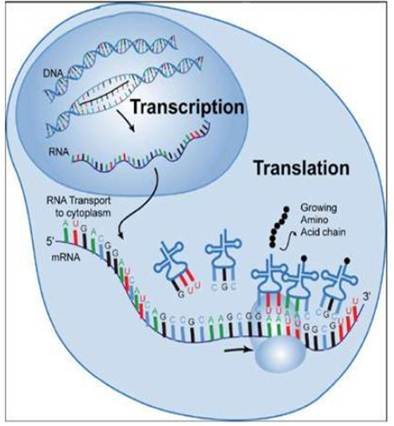

Slide 5
Components of Translation
1. mRNA
2. Ribosomes (rRNA)
3. tRNA
4. Amino Acids (20 Types)
5. Mg2+ (Activator)
6. Amino acyl tRNA Synthetases
7. Initiation, Elongation and Termination Factors

Slide 6
mRNA
mRNA carries the genetic information from DNA in the nucleus to the cytoplasm, where proteins are synthesized.
The sequence of nucleotide bases (adenine (A), uracil (U), guanine (G), and cytosine (C)) on the mRNA dictates the sequence of amino acids in a protein.
mRNA is read in codons, which are groups of three nucleotides. Each codon corresponds to a specific amino acid or a stop signal.

Slide 7
Ribosomes
Structure: Ribosomes are composed of two subunits: a large subunit (50S in prokaryotes, 60S in eukaryotes) and a small subunit (30S in prokaryotes, 40S in eukaryotes).
Together, they form a 70S ribosome in prokaryotes and an 80S ribosome in eukaryotes.
Function: Ribosomes facilitate the binding of tRNA to mRNA and catalyze the formation of peptide bonds between amino acids.

Slide 8
Sites of Ribosomes
They have three key sites:
A site (Aminoacyl site): Where incoming tRNA carrying the next amino acid binds.
P site (Peptidyl site): Holds the tRNA with the growing polypeptide chain.
E site (Exit site): Where the empty tRNA exits the ribosome after transferring its amino acid.

Slide 9
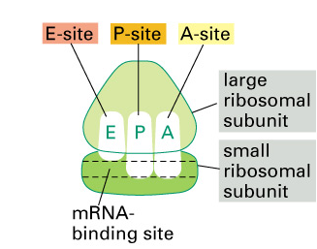

Slide 10
tRNA
Each tRNA molecule has an anticodon that is complementary to the codon on the mRNA. The anticodon allows tRNA to bring the correct amino acid into the ribosome.
At the other end of the tRNA molecule is the amino acid attachment site, where the corresponding amino acid is covalently linked.

Slide 11
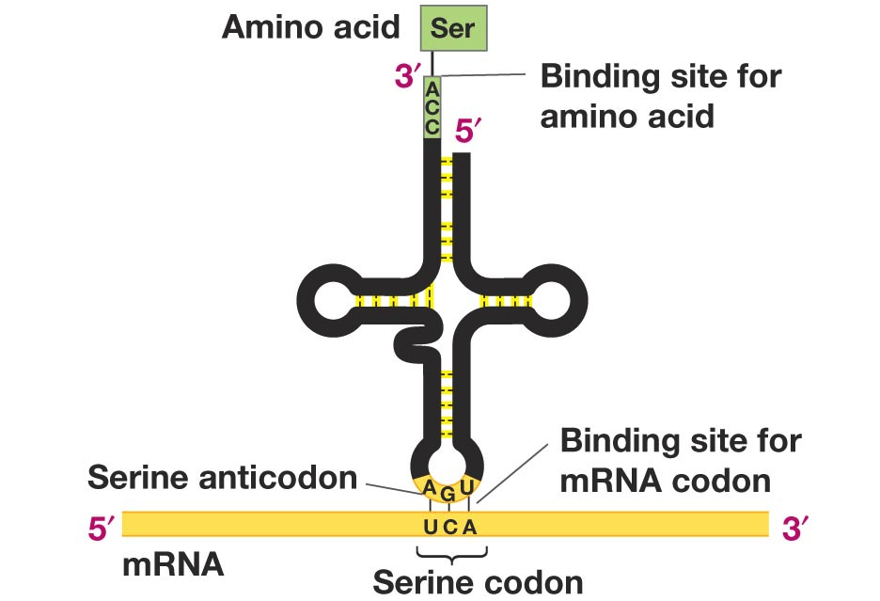

Slide 12
Amino Acids
Amino acids are linked together by peptide bonds to form a polypeptide chain.
There are 20 standard amino acids, each with distinct side chains that determine the protein’s structure and function.

Slide 13
Aminoacyl-tRNA Synthetase
The enzyme aminoacyl-tRNA synthetase ensures the correct amino acid is attached to the appropriate tRNA, a process known as "charging" the tRNA.

Slide 14
Aminoacyl-tRNA Synthetase
A single synthetase may recognize multiple tRNAs.
Two classes of synthetases
Class I - monomeric, acylates the 2´-OH on the terminal ribose
Arg, Cys, Gln, Glu, Ile, Leu, Met, Trp Tyr, Val
Class II - dimeric, acylates the 3´-OH on the terminal ribose
Ala, Asn, Asp, Gly, His, Lys, Phe, Ser, Pro, Thr

Slide 15
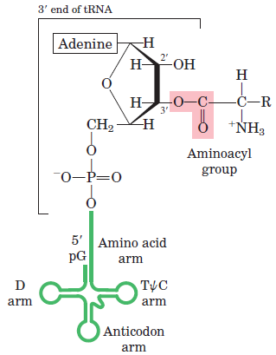
Activation of Amino acid (By Mg2+)
Aminoacid
Aminoacyl t-RNA
t-RNA

Slide 16
Stages of Translation
1. Initiation
2. Elongation
3. Termination

Slide 17
Initiation
Translation begins when the initial portion of an mRNA molecule binds to rRNA molecule in a ribosome.
The mRNA lies on the ribosome in such a way that only one of its codons is exposed at the polypeptide site at any time.
In Prokaryotes, initiation factors recognize the Shine-Dalgarno sequence and aligns the mRNA with the ribosome.
In Prokaryotes, initiation factors recognize the Kozak sequence and aligns the mRNA with the ribosome.

Slide 18
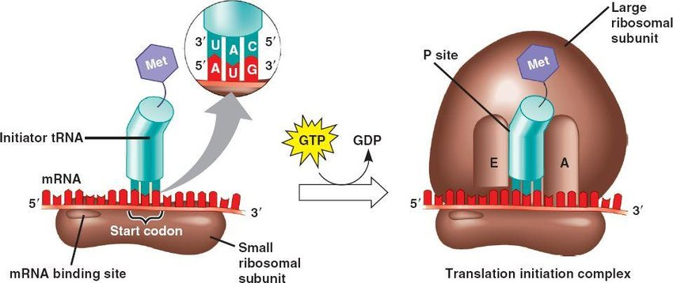

Slide 19
Elongation
Codon Recognition: After initiation, elongation begins when a new tRNA binds to the ribosome's A site. This tRNA has an anticodon that is complementary to the next codon on the mRNA.
Elongation Factors (EFs): These proteins assist in bringing the correct tRNA into the A site and ensure the tRNA is positioned properly. EFs also help move the ribosome along the mRNA.

Slide 20
Elongation
Peptide Bond Formation: The ribosome’s peptidyl transferase activity (an enzymatic function of the large ribosomal subunit) catalyzes the formation of a peptide bond between the amino acid on the tRNA in the A site and the growing polypeptide chain in the P site.
The growing polypeptide chain is now transferred to the tRNA in the A site, leaving the tRNA in the P site empty.

Slide 21
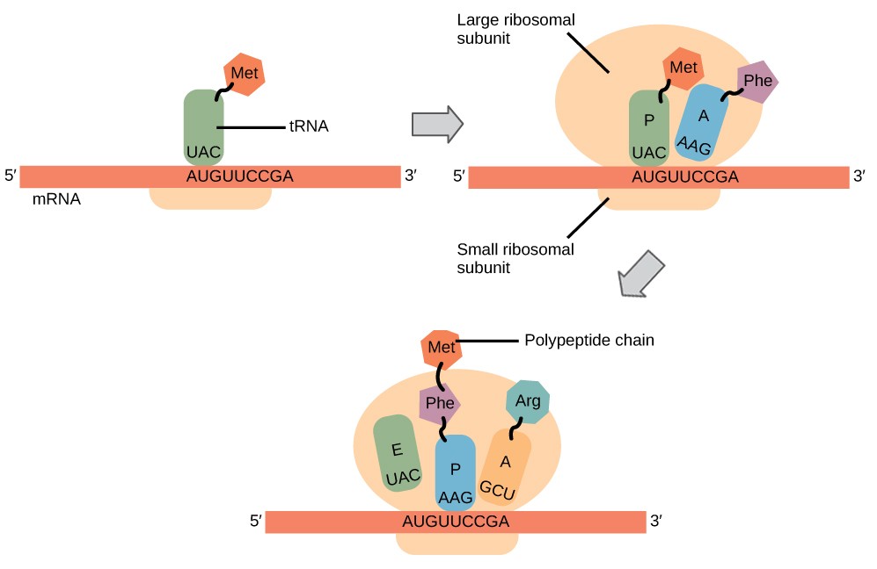

Slide 22
Elongation
Translocation: After the peptide bond is formed, the ribosome moves one codon down the mRNA in a process called translocation.
This shifts the tRNA with the growing peptide chain from the A site to the P site, and the now-empty tRNA from the P site moves to the E site before being released. GTP is hydrolyzed to provide energy for this step.
This process continues as the ribosome moves along the mRNA, reading codons, and adding the corresponding amino acids to the growing chain.

Slide 23
Termination
Stop Codon Recognition: When the ribosome encounters a stop codon (UAA, UAG, or UGA) on the mRNA, no tRNA corresponds to these codons. Instead, release factors (RFs) bind to the ribosome.
Release of the Polypeptide Chain: Release factors promote the hydrolysis of the bond between the tRNA in the P site and the last amino acid of the polypeptide chain. This releases the newly synthesized protein (polypeptide chain).
Dissociation of the Ribosome: After the polypeptide is released, the ribosome disassembles into its large and small subunits, and the mRNA is released. GTP hydrolysis again provides energy for this process.

Slide 24
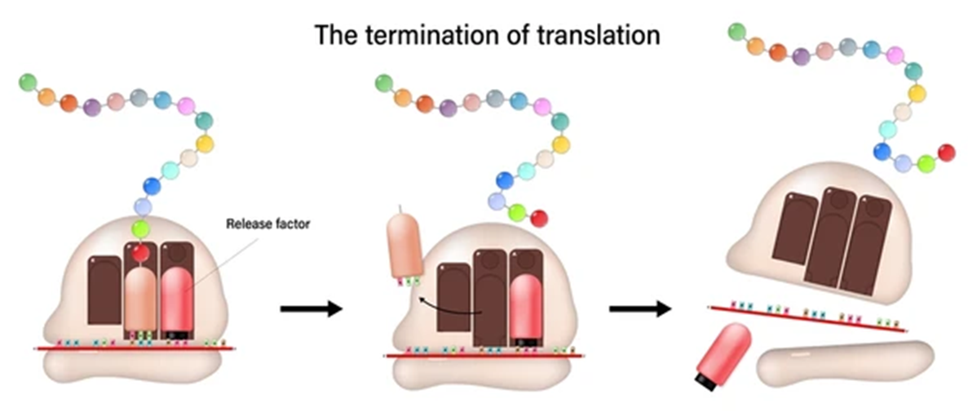

Slide 25


