Slide 1
General and Molecular Biology
Differences in Translation
of Prokaryotes and Eukaryotes
By: Shozab Seemab Khan (PhD Scholar)

Slide 2
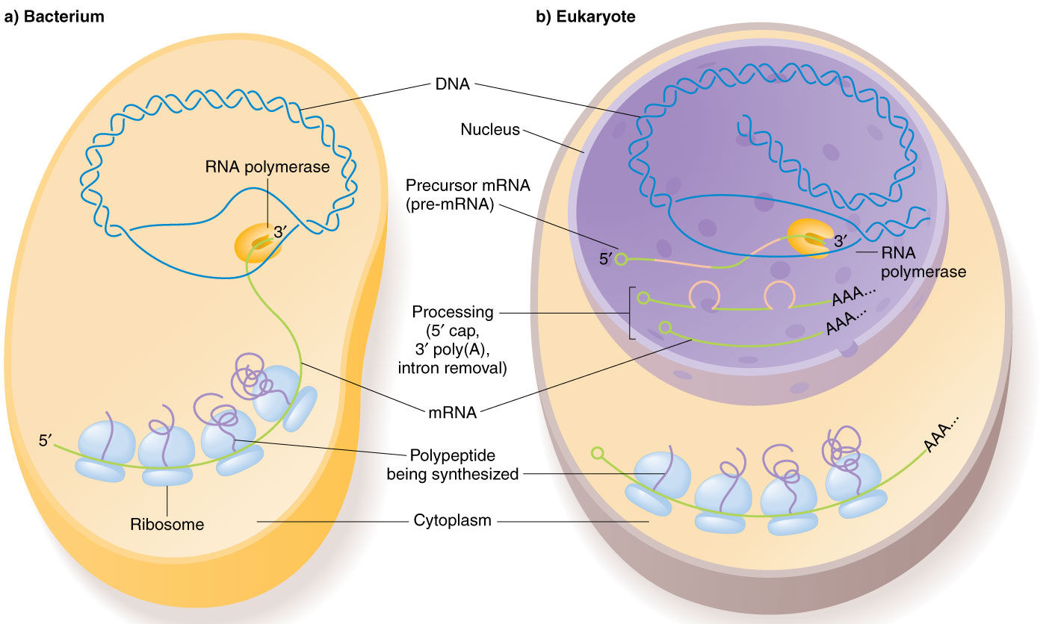

Slide 3
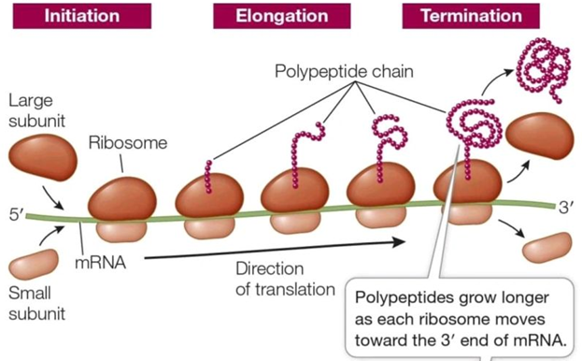

Slide 4
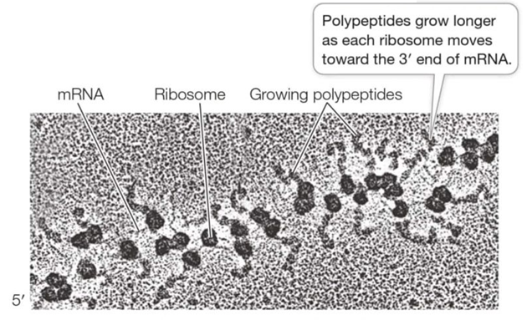

Slide 5
Translation
Translation in biology is the process by which cells create proteins from the instructions encoded in mRNA (messenger RNA).
It is one of the key steps in gene expression, following transcription (when DNA is copied into mRNA).
Translation is almost similar in prokaryotes and eukaryotes apart from some differences.

Slide 6
1. Location
Prokaryotes:
Translation occurs in the cytoplasm, often simultaneously with transcription (coupled process).
Eukaryotes:
Translation occurs in the cytoplasm, after transcription and RNA processing in the nucleus.

Slide 7
2. mRNA Structure
Prokaryotes:
mRNA is often polycistronic (encodes multiple proteins from a single mRNA transcript).
No 5′ cap or poly-A tail.
Contains a Shine-Dalgarno sequence for ribosome binding
Eukaryotes:
mRNA is monocistronic (encodes a single protein per mRNA).
Has a 5′ cap and a 3′ poly-A tail for stability and translation initiation.
Uses a Kozak sequence (5'-GCC(A/G)CCAUGG-3') for ribosome recognition.

Slide 8
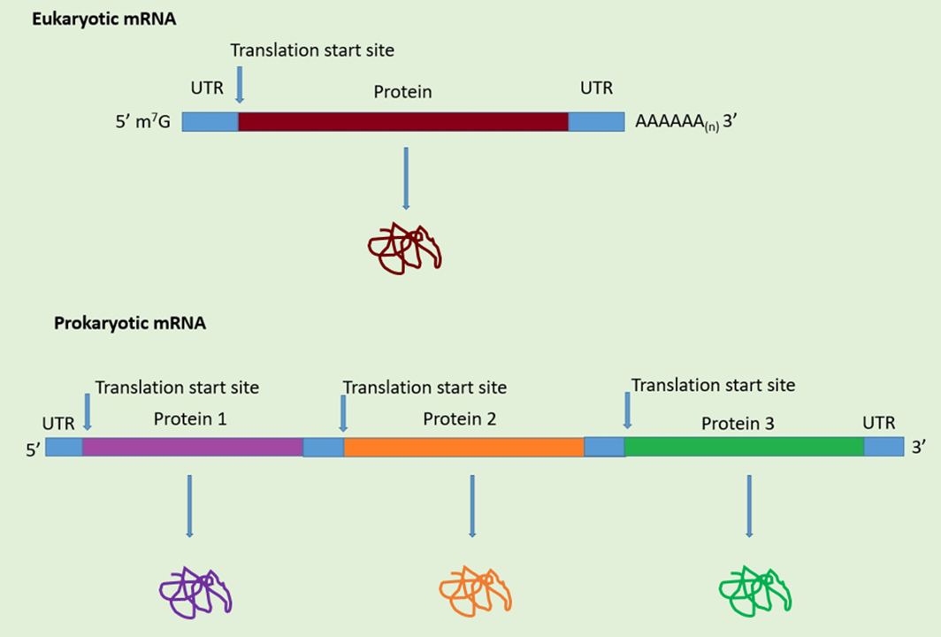

Slide 9
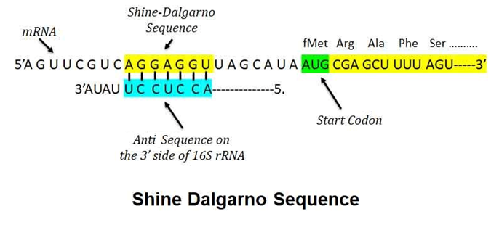

Slide 10
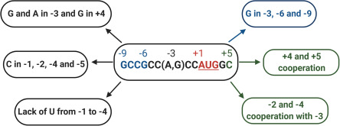
Kozak sequence (5'-GCC(A/G)CCAUGG-3’) in Eukaryotes

Slide 11
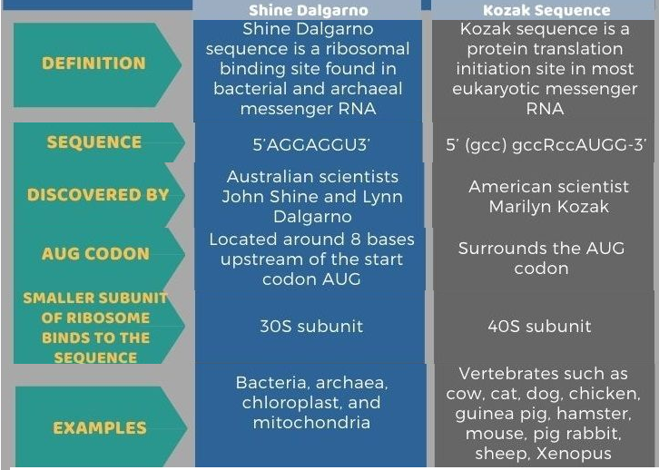

Slide 12
3. Ribosomes
Prokaryotes:
Smaller ribosomes (70S), composed of 50S (large subunit) and 30S (small subunit).
Eukaryotes:
Larger ribosomes (80S), composed of 60S (large subunit) and 40S (small subunit).

Slide 13
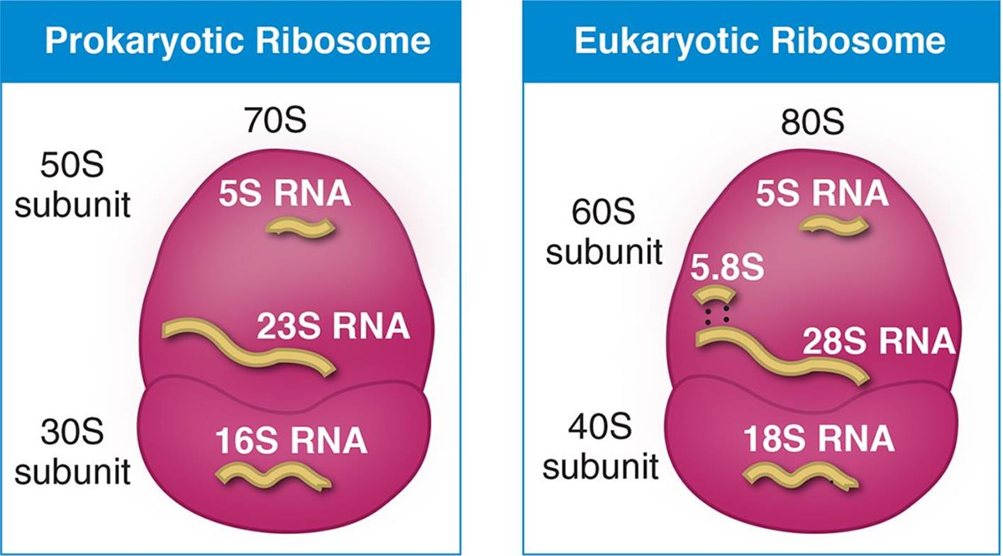

Slide 14
4. Initiation
Prokaryotes:
Initiator tRNA carries N-formylmethionine (fMet).
Translation initiation requires three initiation factors (IF1, IF2, IF3).
The Shine-Dalgarno sequence aligns the mRNA with the ribosome.
Eukaryotes:
Initiator tRNA carries methionine (Met).
Initiation is more complex, involving multiple eukaryotic initiation factors (eIFs).
The 5′ cap and poly-A tail enhance ribosome assembly, and ribosomes scan for the start codon.

Slide 15
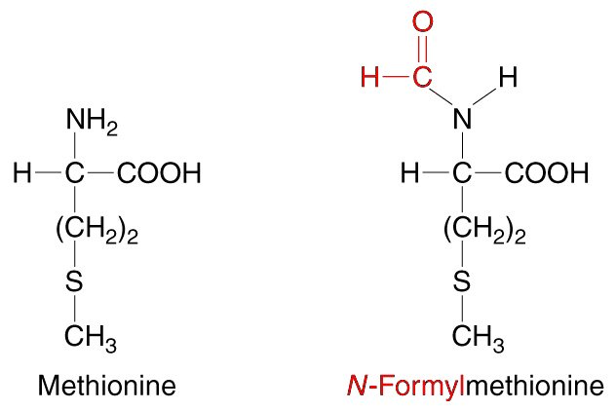

Slide 16
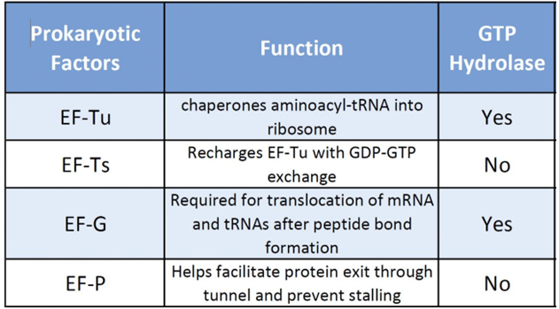
5. Elongation
Elongation factors in Prokaryotes include.

Slide 17
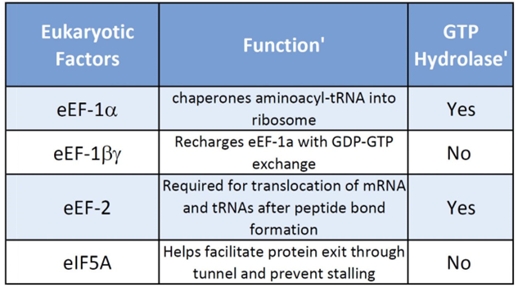
5. Elongation
Elongation factors in eukaryotes are following.

Slide 18
6. Termination
Prokaryotes:
Release factors (RF1 and RF2) recognize stop codons (UAA, UAG, UGA).
Eukaryotes:
A single release factor (eRF1) recognizes all stop codons.

Slide 19
7. Post-Translation Modifications
Prokaryotes:
Minimal post-translational modifications.
Eukaryotes:
Extensive post-translational modifications (e.g., phosphorylation, glycosylation) in the ER and Golgi apparatus.

Slide 20
8. Speed of Translation
Prokaryotes:
Translation is rapid and occurs concurrently with transcription.
About 15–20 amino acids are added per second.
Eukaryotes:
Translation is slower and temporally separated from transcription.
About 5–10 amino acids are added per second.

Slide 21
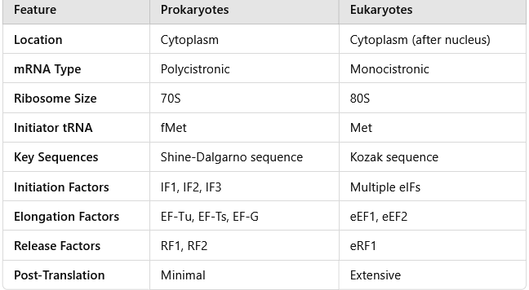

Slide 22
Proofreading
Proofreading Mechanisms:
Aminoacyl-tRNA synthetases have proofreading abilities to ensure that the correct amino acid is attached to the corresponding tRNA. If the wrong amino acid is attached, the enzyme can hydrolyze the incorrect product and attach the correct one.
GTP Hydrolysis:
Many steps in translation, especially the binding and translocation of tRNAs, are coupled with GTP hydrolysis. This coupling ensures that errors in codon recognition are minimized because GTP hydrolysis only occurs if the correct tRNA is bound.

Slide 23
Post-Translational Modifications in Eukaryotes
Once a protein is synthesized, it often undergoes further modifications that are essential for its proper function. These modifications include:
1. Folding: The protein must fold into its correct 3D shape.
2. Chemical Modifications: Proteins can undergo phosphorylation, methylation, glycosylation, or acetylation, which regulate their function, localization, or interactions with other molecules.
3. Transportation: Proteins may be transported to specific areas in the cell (e.g., the nucleus, mitochondria, or plasma membrane) to carry out their functions.

Slide 24
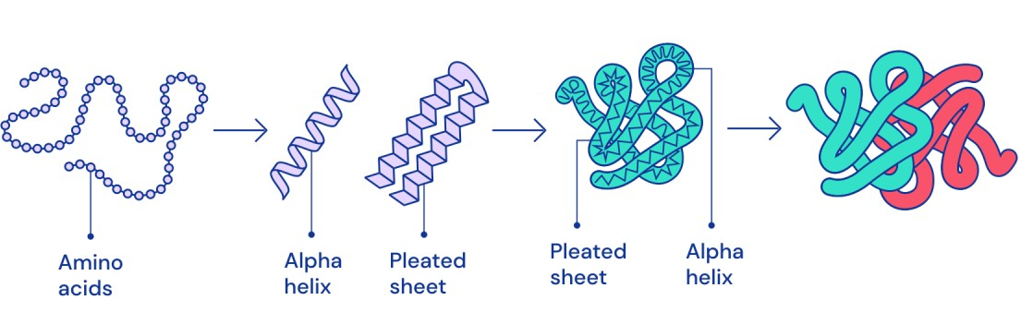

Slide 25


