Slide 1
General and Molecular Genetics
Transcription in Prokaryotes
By: Shozab Seemab Khan (PhD Scholar)

Slide 2
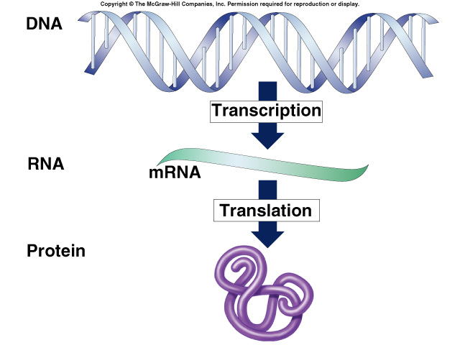

Slide 3
Transcription
The prokaryotes, which include bacteria and archaea, are mostly single-celled organisms that, by definition, lack membrane-bound nuclei and other organelles.
A bacterial chromosome is a covalently closed circle that, unlike eukaryotic chromosomes, is not organized around histone proteins.
The central region of the cell in which prokaryotic DNA resides is called the nucleoid.

Slide 4
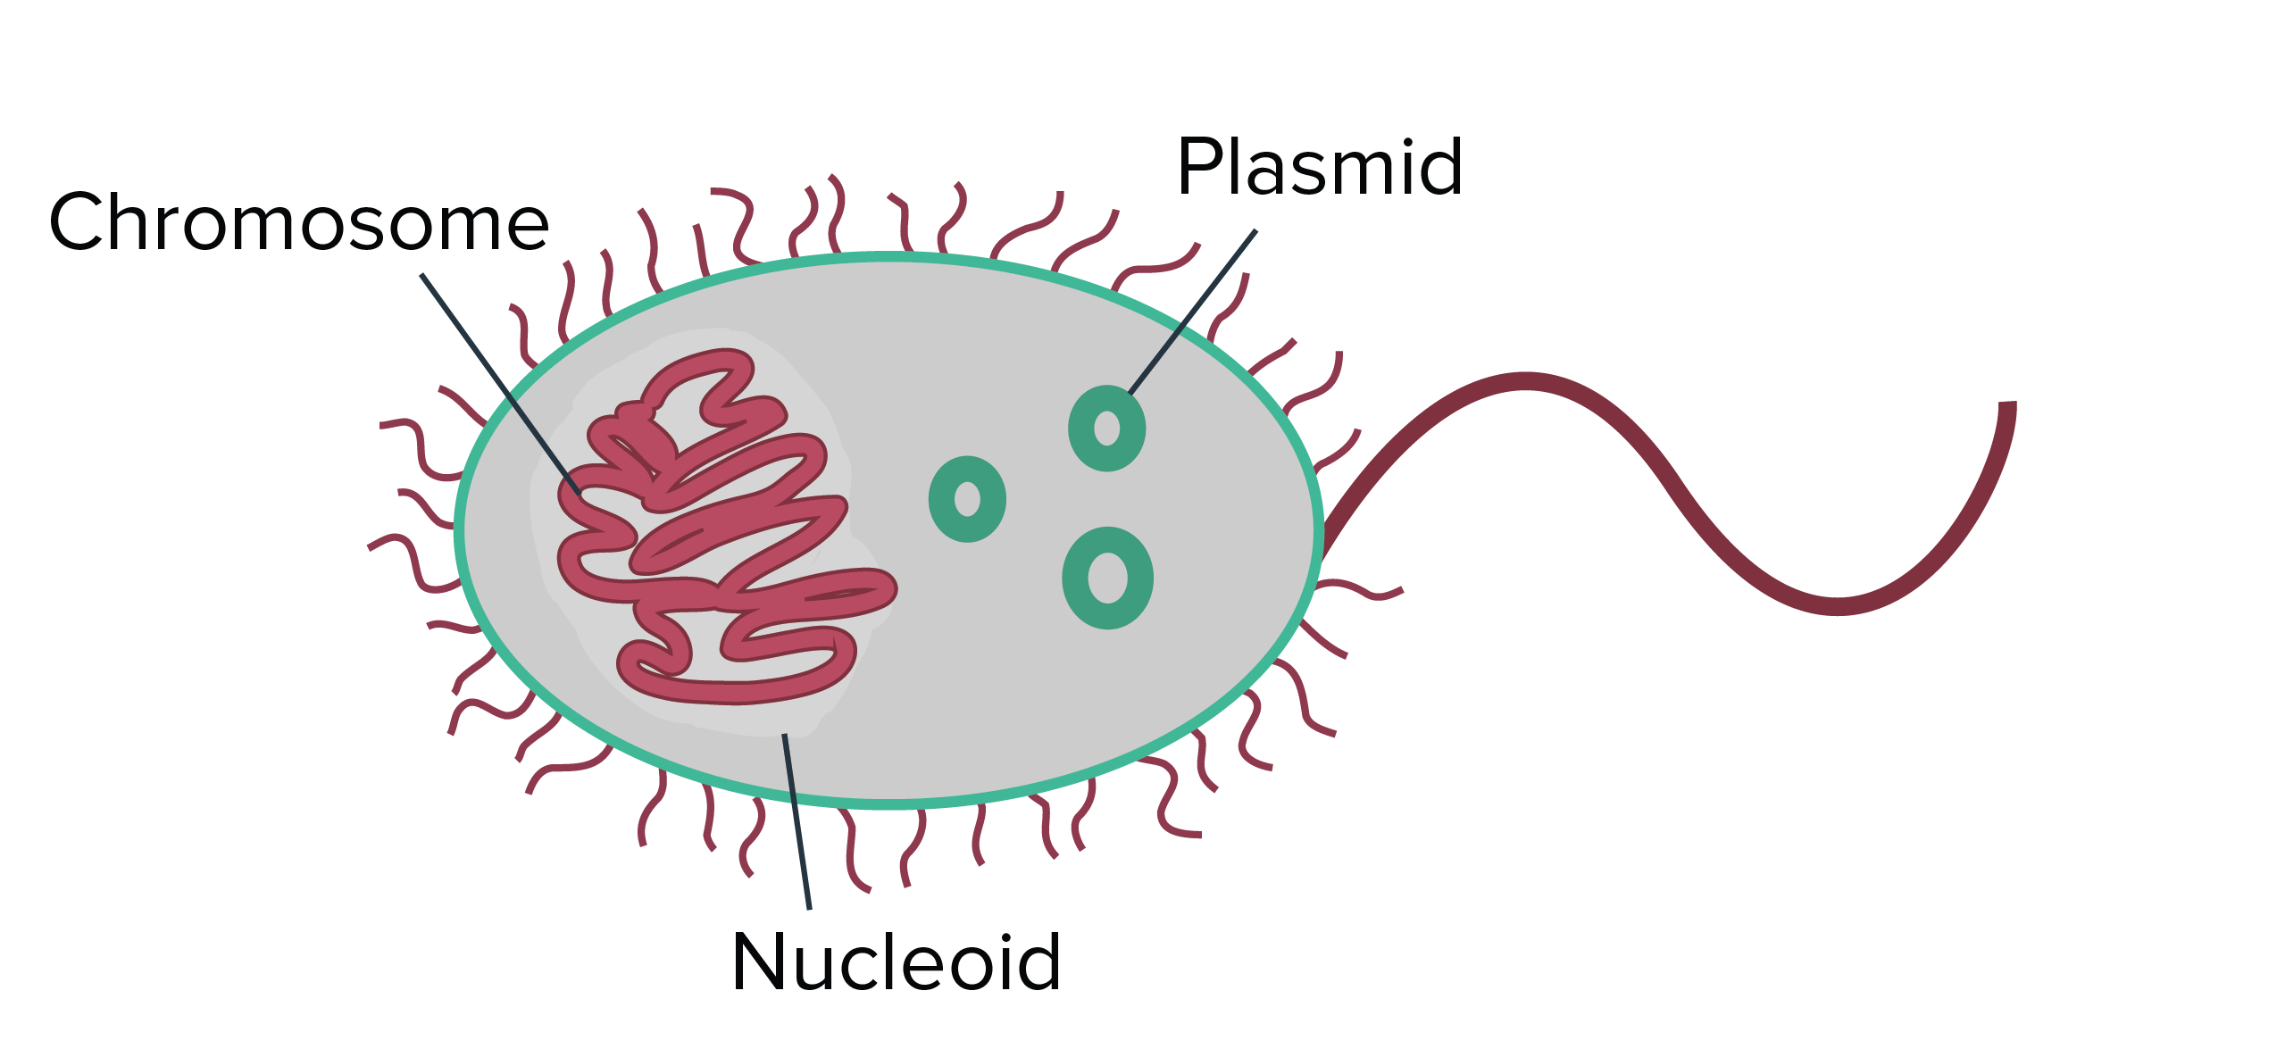

Slide 5
Transcription
In addition, prokaryotes often have abundant plasmids, which are shorter circular DNA molecules that may only contain one or a few genes.
Plasmids can be transferred independently of the bacterial chromosome during cell division and often carry traits such as antibiotic resistance.
Transcription in prokaryotes (and in eukaryotes) requires the DNA double helix to partially unwind in the region of mRNA synthesis. The region of unwinding is called a transcription bubble.

Slide 6
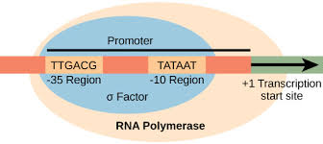
Transcription

Slide 7
Transcription
Transcription always proceeds from the same DNA strand for each gene, which is called the template strand.
The mRNA product is complementary to the template strand and is almost identical to the other DNA strand, called the non-template strand.
The only difference is that in mRNA, all of the T nucleotides are replaced with U nucleotides. In an RNA double helix, A can bind U via two hydrogen bonds, just as in A–T pairing in a DNA double helix.

Slide 8
Transcription
The nucleotide pair in the DNA double helix that corresponds to the site from which the first 5' mRNA nucleotide is transcribed is called the +1 site, or the initiation site.
Nucleotides preceding the initiation site are given negative numbers and are designated upstream.
Conversely, nucleotides following the initiation site are denoted with “+” numbering and are called downstream nucleotides.

Slide 9
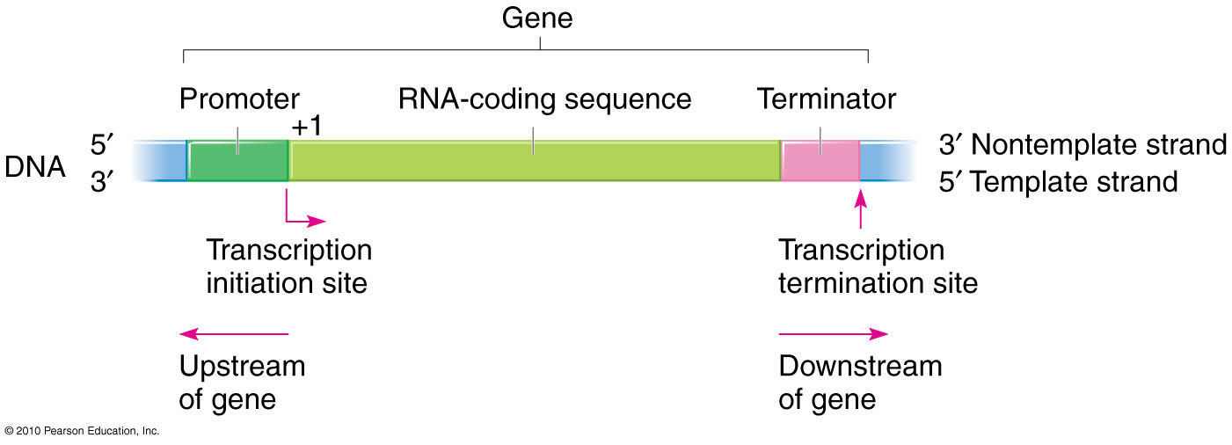
Transcription

Slide 10
Stages of Transcription
Initiation
Elongation
Termination

Slide 11
Initiation of Transcription in Prokaryotes
Prokaryotes do not have membrane-enclosed nuclei.
Therefore, the processes of transcription, translation, and mRNA degradation can all occur simultaneously.
The intracellular level of a bacterial protein can quickly be amplified by multiple transcription and translation events occurring concurrently on the same DNA template.
Prokaryotic transcription often covers more than one gene and produces polycistronic mRNAs that specify more than one protein.
Notes:
Polycistronic mRNAs are RNA molecules that encode multiple proteins, typically in prokaryotes, by having multiple coding sequences (cistrons) within a single transcript.

Slide 12
Notes:
UTR stands for untranslated region

Slide 13
Prokaryotic RNA Polymerase
Prokaryotes use the same RNA polymerase to transcribe all of their genes. In E. coli, the polymerase is composed of five polypeptide subunits, two of which are identical. Four of these subunits, denoted α, α, β, and β' comprise the polymerase core enzyme.
These subunits assemble every time a gene is transcribed, and they disassemble once transcription is complete. Each subunit has a unique role; the two α-subunits are necessary to assemble the polymerase on the DNA; the β-subunit binds to the ribonucleoside triphosphate; and the β' binds the DNA template strand.

Slide 14
Prokaryotic RNA Polymerase
The fifth subunit, σ, is involved only in transcription initiation.
It confers transcriptional specificity such that the polymerase begins to synthesize mRNA from an appropriate initiation site.
Without σ, the core enzyme would transcribe from random sites and would produce mRNA molecules that specified protein is not produced correctly.
The polymerase comprised of all five subunits is called the holoenzyme (α, α, β, β' and σ).

Slide 15
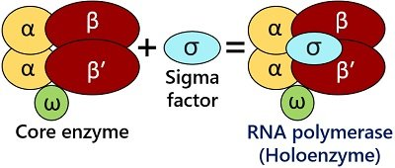
The function of the ω-subunit (omega) is not known.
Notes:
UTR stands for untranslated region

Slide 16
Prokaryotic Promoters
A promoter is a DNA sequence onto which the transcription machinery binds and initiates transcription. In most cases, promoters exist upstream of the genes they regulate.
The specific sequence of a promoter is very important because it determines whether the corresponding gene is transcribed all the time, some of the time, or infrequently.
Although promoters vary among prokaryotic genomes, a few elements are conserved. At the -10 and -35 regions upstream of the initiation site, there are two promoter consensus sequences, or regions that are similar across all promoters and across various bacterial species.

Slide 17
Prokaryotic Promoters
The -10 consensus sequence, called the -10 region, is TATAAT. The -35 sequence, TTGACA, is recognized and bound by σ.
Once this interaction is made, the subunits of the core enzyme bind to the site. The A–T-rich -10 region facilitates unwinding of the DNA template, and several phosphodiester bonds are made.
The transcription initiation phase ends with the production of abortive transcripts, which are polymers of approximately 10 nucleotides that are made and released.

Slide 18
The σ subunit of prokaryotic RNA polymerase recognizes consensus sequences found in the promoter region upstream of the transcription start sight. The σ subunit dissociates from the polymerase after transcription has been initiated.

Slide 19
Elongation in Prokaryotes
The transcription elongation phase begins with the release of the σ subunit from the polymerase.
The dissociation of σ allows the core enzyme to proceed along the DNA template, synthesizing mRNA in the 5' to 3' direction at a rate of approximately 40 nucleotides per second.
As elongation proceeds, the DNA is continuously unwound ahead of the core enzyme and rewound behind it.

Slide 20
Elongation in Prokaryotes
The base pairing between DNA and RNA is not stable enough to maintain the stability of the mRNA synthesis components.
Instead, the RNA polymerase acts as a stable linker between the DNA template and the nascent RNA strands to ensure that elongation is not interrupted prematurely.
Notes:
Nascent RNA strands are newly synthesized RNA molecules that are still being transcribed by RNA polymerase and have not yet undergone post-transcriptional modifications.

Slide 21
During elongation, the prokaryotic RNA polymerase tracks along the DNA template, synthesizes mRNA in the 5’ to 3' direction, and unwinds and rewinds the DNA as it is read.

Slide 22
Prokaryotic Termination Signals
Once a gene is transcribed, the prokaryotic polymerase needs to be instructed to dissociate from the DNA template and liberate the newly made mRNA.
Depending on the gene being transcribed, there are two kinds of termination signals. One is protein-based and the other is RNA-based.
Rho-dependent termination is controlled by the rho protein, which tracks along behind the polymerase on the growing mRNA chain.
Near the end of the gene, the polymerase encounters a run of G nucleotides on the DNA template and it stalls. As a result, the rho protein collides with the polymerase. The interaction with rho releases the mRNA from the transcription bubble.

Slide 23
Prokaryotic Termination Signals
Rho-independent termination is controlled by specific sequences in the DNA template strand. As the polymerase nears the end of the gene being transcribed, it encounters a region rich in C–G nucleotides.
The mRNA folds back on itself, and the complementary C–G nucleotides bind together. The result is a stable hairpin that causes the polymerase to stall as soon as it begins to transcribe a region rich in A–T nucleotides.
The complementary U–A region of the mRNA transcript forms only a weak interaction with the template DNA. This, coupled with the stalled polymerase, induces enough instability for the core enzyme to break away and liberate the new mRNA transcript.

Slide 24
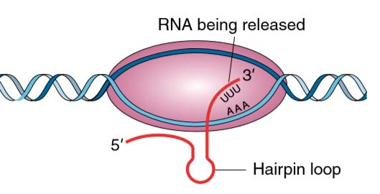

Slide 25
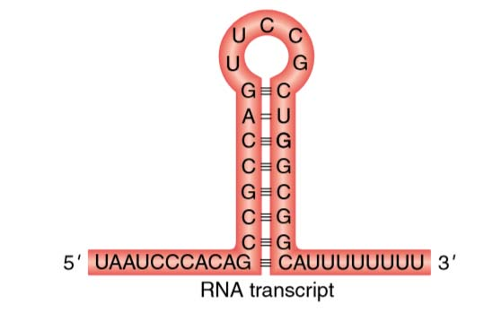

Slide 26
Prokaryotic Termination Signals
Upon termination, the process of transcription is complete.
By the time termination occurs, the prokaryotic transcript would already have been used to begin synthesis of numerous copies of the encoded protein because these processes can occur concurrently.
The unification of transcription, translation, and even mRNA degradation is possible because all of these processes occur in the same 5’ to 3' direction, and because there is no membranous compartmentalization in the prokaryotic cell.
In contrast, the presence of a nucleus in eukaryotic cells prevents simultaneous transcription and translation.

Slide 27
Multiple polymerases can transcribe a single bacterial gene while numerous ribosomes concurrently translate the mRNA transcripts into polypeptides. In this way, a specific protein can rapidly reach a high concentration in the bacterial cell.

Slide 28
Summary
In prokaryotes, mRNA synthesis is initiated at a promoter sequence on the DNA template comprising two consensus sequences that recruit RNA polymerase.
The prokaryotic polymerase consists of a core enzyme of four protein subunits and a σ protein that assists only with initiation.
Elongation synthesizes mRNA in the 5' to 3' direction at a rate of 40 nucleotides per second. Termination liberates the mRNA and occurs either by rho protein interaction or by the formation of an mRNA hairpin.

Slide 29
Terms
Consensus: DNA sequence that is used by many species to perform the same or similar functions
Core enzyme: Prokaryotic RNA polymerase consisting of α, α, β, and β' but missing σ; this complex performs elongation
Downstream: Nucleotides following the initiation site in the direction of mRNA transcription; in general, sequences that are toward the 3' end relative to a site on the mRNA
Hairpin: Structure of RNA when it folds back on itself and forms intramolecular hydrogen bonds between complementary nucleotides
Holoenzyme: Prokaryotic RNA polymerase consisting of α, α, β, β', and σ; this complex is responsible for transcription initiation

Slide 30
Terms
Initiation site: Nucleotide from which mRNA synthesis proceeds in the 5' to 3' direction; denoted with a “+1”
Non-Template Strand: Strand of DNA that is not used to transcribe mRNA; this strand is identical to the mRNA except that T nucleotides in the DNA are replaced by U nucleotides in the mRNA
Plasmid: Extrachromosomal, covalently closed, circular DNA molecule that may only contain one or a few genes; common in prokaryotes
Promoter: DNA sequence to which RNA polymerase and associated factors bind and initiate transcription
Rho-Dependent Termination: In prokaryotes, termination of transcription by an interaction between RNA polymerase and the rho protein at a run of G nucleotides on the DNA template

Slide 31
Terms
Rho-Independent: Termination sequence-dependent termination of prokaryotic mRNA synthesis; caused by hairpin formation in the mRNA that stalls the polymerase
TATA Box: Conserved promoter sequence in eukaryotes and prokaryotes that helps to establish the initiation site for transcription template strand of DNA that specifies the complementary mRNA molecule
Transcription bubble: Region of locally unwound DNA that allows for transcription of mRNA
Upstream: Nucleotides preceding the initiation site; in general, sequences toward the 5' end relative to a site on the mRNA

Slide 32
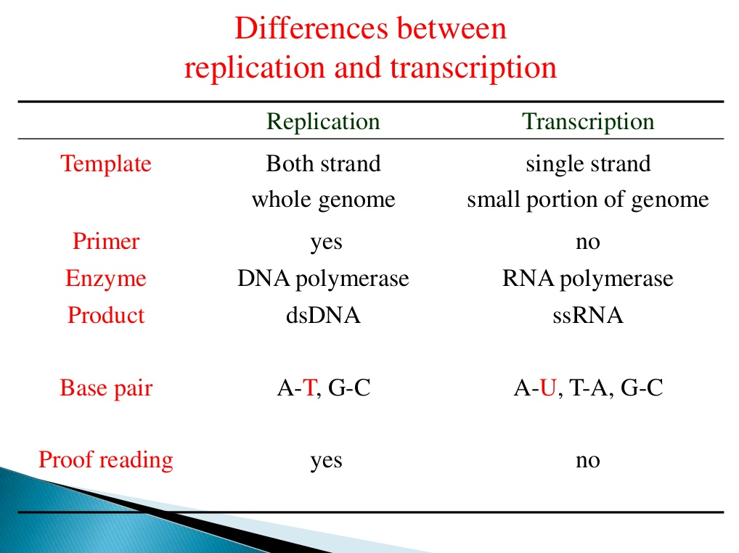

Slide 33


