Slide 1
General and Molecular Genetics
Transcription in Eukaryotes
By: Shozab Seemab Khan (PhD Scholar)

Slide 2
Difference in Transcription of Eukaryotes
Prokaryotes and eukaryotes perform fundamentally the same process of transcription, with a few key differences.
The most important difference between prokaryotes and eukaryotes is the membrane-bound nucleus and organelles.
With the genes bound in a nucleus, the eukaryotic cell must be able to transport its mRNA to the cytoplasm and must protect its mRNA from degrading before it is translated.

Slide 3
Difference in Transcription of Eukaryotes
Eukaryotes also employ three different polymerases that each transcribe a different subset of genes.
Eukaryotic mRNAs are usually monogenic, meaning that they specify a single protein.
Unlike the prokaryotic polymerase that can bind to a DNA template on its own, eukaryotes require several other proteins, called transcription factors, to first bind to the promoter region and then help recruit the appropriate polymerase.

Slide 4
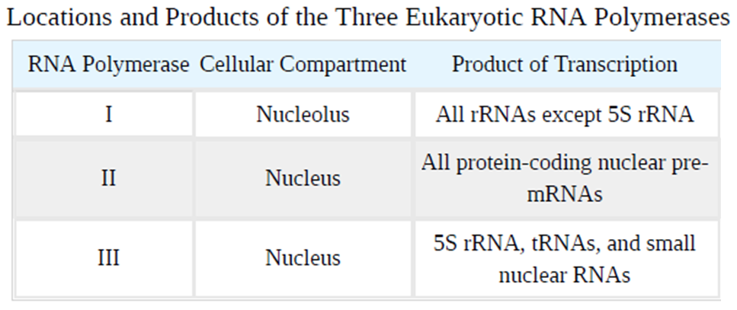

Slide 5
The Three Eukaryotic RNA Polymerases
The features of eukaryotic mRNA synthesis are markedly more complex those of prokaryotes.
Instead of a single polymerase comprising five subunits, the eukaryotes have three polymerases that are each made up of 10 subunits or more.
Each eukaryotic polymerase also requires a distinct set of transcription factors to bring it to the DNA template.

Slide 6
Role of RNA Polymerase I
RNA polymerase I is located in the nucleolus, a specialized nuclear sub-structure in which ribosomal RNA (rRNA) is transcribed, processed, and assembled into ribosomes.
The rRNA molecules are considered structural RNAs because they have a cellular role but are not translated into protein.

Slide 7
Role of RNA Polymerase I
RNA polymerase I synthesizes all of the rRNAs except for the 5S rRNA molecule.
The rRNAs are components of the ribosome and are essential to the process of translation.
The “S” designation applies to “Svedberg” units, a non-additive value that characterizes the speed at which a particle sediments during centrifugation.

Slide 8
Role of RNA Polymerase II
RNA polymerase II is located in the nucleus and synthesizes all protein-coding nuclear pre-mRNAs.
Eukaryotic pre-mRNAs undergo extensive processing after transcription but before translation.
RNA polymerase II is responsible for transcribing the overwhelming majority of eukaryotic genes.

Slide 9
Role of RNA Polymerase III
RNA polymerase III is also located in the nucleus. This polymerase transcribes a variety of structural RNAs that includes the 5S pre-rRNA, transfer pre-RNAs (pre-tRNAs), and small nuclear pre-RNAs.
The tRNAs have a critical role in translation; they serve as the adaptor molecules between the mRNA template and the growing polypeptide chain.
Small nuclear RNAs have a variety of functions, including “splicing” pre-mRNAs and regulating transcription factors.

Slide 10
Effect of Poison on RNA Polymerase
α-amanitin produced by Amanita phalloides, the Death Cap mushroom, affects the three polymerases very differently.
RNA polymerase I is completely insensitive to α-amanitin, meaning that the polymerase can transcribe DNA in vitro in the presence of this poison.
In contrast, RNA polymerase II is extremely sensitive to α-amanitin, and RNA polymerase III is moderately sensitive.

Slide 11
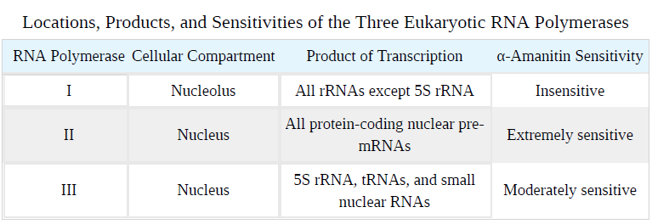

Slide 12
Structure of an RNA Polymerase II Promoter
Eukaryotic promoters are much larger and more complex than prokaryotic promoters, but both have a TATA box. For example, in the mouse thymidine kinase gene, the TATA box is located at approximately -30 relative to the initiation (+1) site.
For this gene, the exact TATA box sequence is TATAAAA, as read in the 5' to 3' direction on the non-template strand. This sequence is not identical to the E. coli TATA box, but it conserves the A–T rich element.
The thermostability of A–T bonds is low and this helps the DNA template to locally unwind in preparation for transcription.

Slide 13
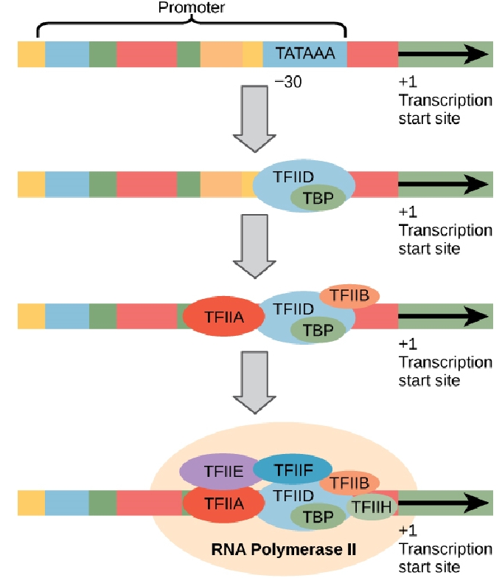
A generalized promoter of a gene transcribed by RNA polymerase II is shown. Transcription factors recognize the promoter. RNA polymerase II then binds and forms the transcription initiation complex.
A scientist splices a eukaryotic promoter in front of a bacterial gene and inserts the gene in a bacterial chromosome. Would you expect the bacteria to transcribe the gene?
Notes:
Eukaryotic promoters are not functional in bacteria due to differences in transcriptional machinery. For the bacterial gene to be transcribed in this case, a compatible bacterial promoter must be used.

Slide 14
Structure of an RNA Polymerase II Promoter
This sequence (TATA box sequence TATAAAA) is essential and is involved in binding transcription factors. Further upstream of the TATA box, eukaryotic promoters may also contain one or more GC-rich boxes (GGCG) or octamer boxes (ATTTGCAT).
These elements bind cellular factors that increase the efficiency of transcription initiation and are often identified in more “active” genes that are constantly being expressed by the cell.

Slide 15
Transcription Factors for RNA Polymerase II
The complexity of eukaryotic transcription does not end with the polymerases and promoters. An army of basal transcription factors, enhancers, and silencers also help to regulate the frequency with which pre-mRNA is synthesized from a gene.
Enhancers and silencers affect the efficiency of transcription but are not necessary for transcription to proceed.
Basal transcription factors are crucial in the formation of a pre-initiation complex on the DNA template that subsequently recruits RNA polymerase II for transcription initiation.

Slide 16
Transcription Factors for RNA Polymerase II
The names of the basal transcription factors begin with “TFII” (this is the transcription factor for RNA polymerase II) and are specified with the letters A–J.
The transcription factors systematically fall into place on the DNA template, with each one further stabilizing the preinitiation complex and contributing to the recruitment of RNA polymerase II.

Slide 17
Transcription Factors for RNA Polymerase II
The processes of bringing RNA polymerases I and III to the DNA template involve slightly less complex collections of transcription factors, but the general theme is the same.
Eukaryotic transcription is a tightly regulated process that requires a variety of proteins to interact with each other and with the DNA strand.
Although the process of transcription in eukaryotes involves a greater metabolic investment than in prokaryotes, it ensures that the cell transcribes precisely the pre-mRNAs that it needs for protein synthesis.

Slide 18
Promoter Structures for RNA Polymerase I
In eukaryotes, the conserved promoter elements differ for genes transcribed by RNA polymerases I, II, and III.
RNA polymerase I transcribes genes that have two GC-rich promoter sequences in the -45 to +20 region.
These sequences alone are sufficient for transcription initiation to occur, but promoters with additional sequences in the region from -180 to -105 upstream of the initiation site will further enhance initiation.

Slide 19
Promoter Structures for RNA Polymerase III
RNA Polymerase III promoters are of 3 types.
1. Type I Promoters: Found in 5S rRNA genes. Internal promoter elements located within the transcribed region:
2. Type II Promoters: Found in tRNA genes. Internal promoter elements also located within the coding region:
3. Type III Promoters: Found in non-coding RNA genes such as U6 snRNA and other small RNAs. These are upstream promoter elements, located outside the transcribed region.
Each of these promoter types interacts with specific transcription factors (e.g., TFIIIA, TFIIIB, TFIIIC) to recruit RNA Polymerase III and initiate transcription.

Slide 20
Eukaryotic Elongation
Following the formation of the pre-initiation complex, the polymerase is released from the other transcription factors, and elongation is allowed to proceed as it does in prokaryotes with the polymerase synthesizing pre-mRNA in the 5' to 3' direction.
RNA polymerase II transcribes the major share of eukaryotic genes necessary for translation.

Slide 21
Eukaryotic Elongation
Although the enzymatic process of elongation is essentially the same in eukaryotes and prokaryotes, the DNA template is more complex. When eukaryotic cells are not dividing, their genes exist as a diffuse mass of DNA and proteins called chromatin.
The DNA is tightly packaged around charged histone proteins at repeated intervals. These DNA–histone complexes, collectively called nucleosomes, are regularly spaced and include 146 nucleotides of DNA wound around eight histones like thread around a spool.

Slide 22
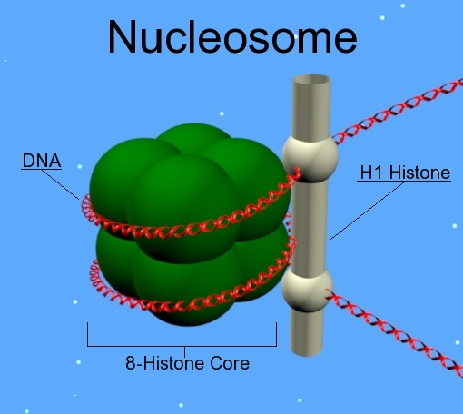

Slide 23
Eukaryotic Elongation
For polynucleotide synthesis to occur, the transcription machinery needs to move histones out of the way every time it encounters a nucleosome.
This is accomplished by a special protein complex called FACT, which stands for “facilitates chromatin transcription.”
This complex pulls histones away from the DNA template as the polymerase moves along it. Once the pre-mRNA is synthesized, the FACT complex replaces the histones to recreate the nucleosomes.

Slide 24
Eukaryotic Termination
The termination of transcription is different for the different polymerases.
Unlike in prokaryotes, elongation by RNA polymerase II in eukaryotes takes place 1,000–2,000 nucleotides after the end of the gene being transcribed.
This pre-mRNA tail is subsequently removed by cleavage during mRNA processing.

Slide 25
Eukaryotic Termination
On the other hand, RNA polymerases I and III require termination signals.
Genes transcribed by RNA polymerase I contain a specific 18-nucleotide sequence that is recognized by a termination protein.
The process of termination in RNA polymerase III involves an mRNA hairpin similar to rho-independent termination of transcription in prokaryotes.

Slide 26
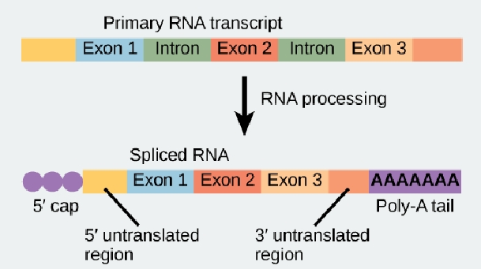
mRNA Processing in Eukaryotes
Eukaryotic mRNA contains introns that must be spliced out. A 5' cap and 3' poly-A tail are also added.
Notes:
Introns are non-coding regions of a gene that are transcribed into pre-mRNA but are removed during RNA splicing because they do not code for proteins and must be excluded to produce a functional mRNA transcript.
The 5' cap of eukaryotic mRNA is made up of a modified 7-methylguanosine (m7G) nucleotide attached to the 5' end of the mRNA via a unique 5'-to-5' triphosphate linkage.

Slide 27
Summary
Transcription in eukaryotes involves one of three types of polymerases, depending on the gene being transcribed.
RNA polymerase II transcribes all of the protein-coding genes, whereas RNA polymerase I transcribes rRNA genes, and RNA polymerase III transcribes rRNA, tRNA, and small nuclear RNA genes.
The initiation of transcription in eukaryotes involves the binding of several transcription factors to complex promoter sequences that are usually located upstream of the gene being copied.

Slide 28
Summary
The mRNA is synthesized in the 5' to 3' direction, and the FACT complex moves and reassembles nucleosomes as the polymerase passes by.
Whereas RNA polymerases I and III terminate transcription by protein- or RNA hairpin-dependent methods, RNA polymerase II transcribes for 1,000 or more nucleotides beyond the gene template and cleaves the excess during pre-mRNA processing.

Slide 29
Terms
CAAT box: (GGCCAATCT) essential eukaryotic promoter sequence involved in binding transcription factors.
FACT: Complex that “facilitates chromatin transcription” by disassembling nucleosomes ahead of a transcribing RNA polymerase II and reassembling them after the polymerase passes by.
GC-rich box: (GGCG) non-essential eukaryotic promoter sequence that binds cellular factors to increase the efficiency of transcription; may be present several times in a promoter

Slide 30
Terms
Octamer box:
(ATTTGCAT) nonessential eukaryotic promoter sequence that binds cellular factors to increase the efficiency of transcription; may be present several times in a promoter.
Pre-initiation complex:
Cluster of transcription factors and other proteins that recruit RNA polymerase II for transcription of a DNA template.
Small nuclear RNA:
Molecules synthesized by RNA polymerase III that have a variety of functions, including splicing pre-mRNAs and regulating transcription factors.

Slide 31


