Slide 1
General and Molecular Genetics
DNA Repair
By: Shozab Seemab Khan (PhD Scholar)

Slide 2
DNA Repair
DNA replication is a highly accurate process, but mistakes can occasionally occur, such as a DNA polymerase inserting a wrong base.
Uncorrected mistakes may sometimes lead to serious consequences, such as cancer. Repair mechanisms correct the mistakes.
In rare cases, mistakes are not corrected, leading to mutations; in other cases, repair enzymes are themselves mutated or defective.

Slide 3
DNA Repair
Most of the mistakes during DNA replication are promptly corrected by DNA polymerase by proofreading the base that has been just added. In proofreading, the DNA pol reads the newly added base before adding the next one, so a correction can be made. The polymerase checks whether the newly added base has paired correctly with the base in the template strand.
If it is the right base, the next nucleotide is added. If an incorrect base has been added, the enzyme makes a cut at the phosphodiester bond and releases the wrong nucleotide. This is performed by the exonuclease action of DNA pol III. Once the incorrect nucleotide has been removed, a new one will be added again.

Slide 4
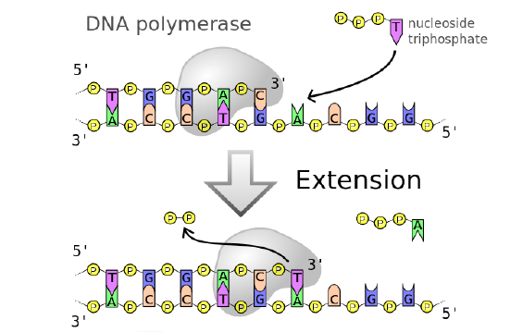

Slide 5
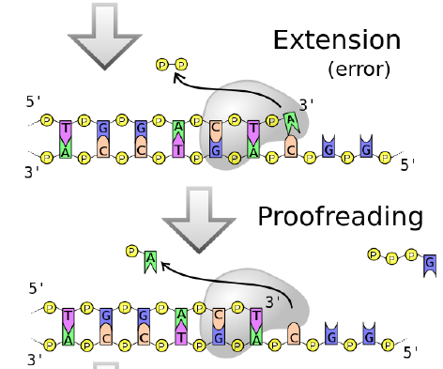

Slide 6
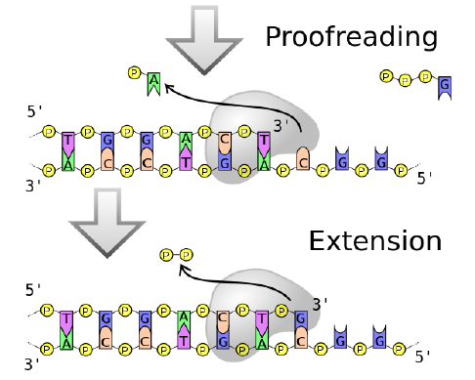

Slide 7
DNA Repair
Some errors are not corrected during replication, but are instead corrected after replication is completed; this type of repair is known as mismatch repair. The enzymes recognize the incorrectly added nucleotide and excise it; this is then replaced by the correct base.
If this remains uncorrected, it may lead to more permanent damage. How do mismatch repair enzymes recognize which of the two bases is the incorrect one? In E. coli, after replication, the nitrogenous base adenine acquires a methyl group (CH3); the parental DNA strand will have methyl groups, whereas the newly synthesized strand lacks them.

Slide 8
DNA Repair
Thus, DNA polymerase is able to remove the wrongly incorporated bases from the newly synthesized, non-methylated strand. In eukaryotes, the mechanism is not very well understood.
But it is believed to involve recognition of unsealed nicks in the new strand, as well as a short-term continuing association of some of the replication proteins with the new daughter strand after replication has completed.

Slide 9
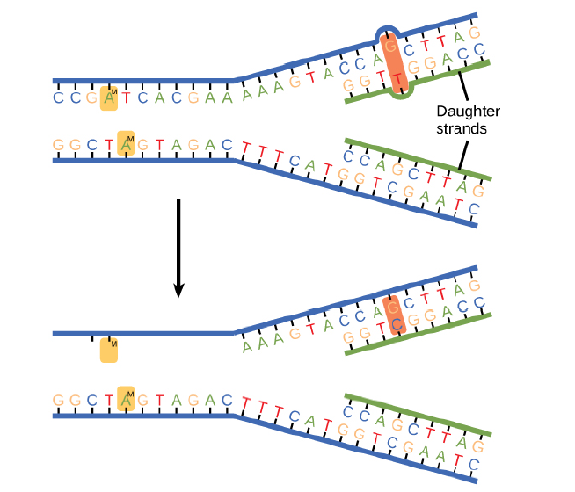
In mismatch repair, the incorrectly added base is detected after replication. The mismatch repair proteins detect this base and remove it from the newly synthesized strand by nuclease action. The gap is now filled with the correctly paired base

Slide 10
DNA Repair
In another type of repair mechanism, nucleotide excision repair, enzymes replace incorrect bases by making a cut on both the 3′ and 5′ ends of the incorrect base. The segment of DNA is removed and replaced with the correctly paired nucleotides by the action of DNA pol.
Once the bases are filled in, the remaining gap is sealed with a phosphodiester linkage catalyzed by DNA ligase. This repair mechanism is often employed when UV exposure causes the formation of thymine-thymine dimers.

Slide 11
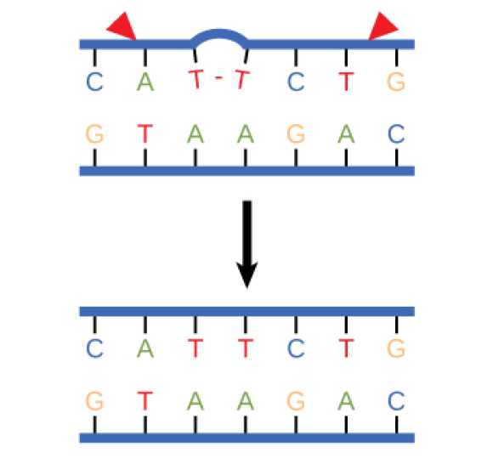

Slide 12
DNA Repair
A well-studied example of mistakes not being corrected is seen in people suffering from xeroderma pigmentosa. Affected individuals have skin that is highly sensitive to UV rays from the sun.
When individuals are exposed to UV, pyrimidine dimers, especially those of thymine, are formed; people with xeroderma pigmentosa are not able to repair the damage.

Slide 13
DNA Repair
These are not repaired because of a defect in the nucleotide excision repair enzymes, whereas in normal individuals, the thymine dimers are excised and the defect is corrected.
The thymine dimers distort the structure of the DNA double helix, and this may cause problems during DNA replication.
People with xeroderma pigmentosa have a higher risk of contracting skin cancer than those who don’t have the condition.

Slide 14
DNA Repair
Errors during DNA replication are not the only reason why mutations arise in DNA. Mutations, variations in the nucleotide sequence of a genome, can also occur because of damage to DNA.
Such mutations may be of two types: induced or spontaneous. Induced mutations are those that result from an exposure to a mutagen: chemicals, UV rays, x-rays, or some other environmental agent.
Spontaneous mutations occur without any exposure to any environmental agent; they are a result of natural reactions taking place within the body.

Slide 15
DNA Repair
Mutations may have a wide range of effects. Some mutations are not expressed; these are known as silent mutations. Other mutations can have serious effects on the organism (such as the mutation that causes xeroderma pigmentosa).
Mutations in repair genes have been known to cause cancer. Many mutated repair genes have been implicated in certain forms of pancreatic cancer, colon cancer, and colorectal cancer. Mutations can affect either somatic cells or gametes. If many mutations accumulate in a somatic cell, they may lead to problems such as the uncontrolled cell division observed in cancer. If a mutation takes place in a gamete, the mutation can be passed on to the next generation.

Slide 16
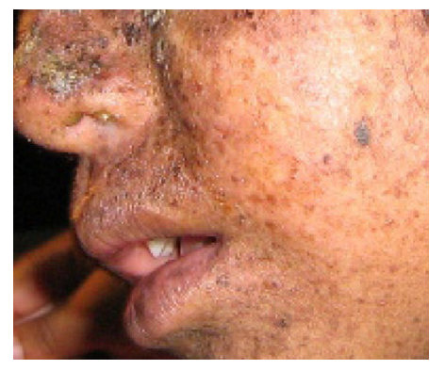

Slide 17


