Slide 1
General and Molecular Genetics
DNA Damaging Agents
By: Shozab Seemab Khan (PhD Scholar)

Slide 2
DNA Damaging Agents
DNA-damaging agents are chemicals, physical factors, biological processes or environmental agents that can cause alterations in the DNA structure, which need DNA repair and can also lead to mutations, cell death, or cancer.
These agents can act on DNA directly or indirectly by generating reactive species that interact with DNA.

Slide 3
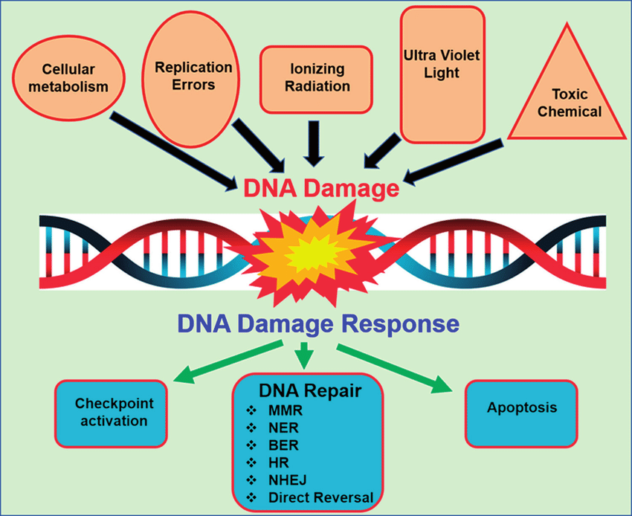

Slide 4
1. Chemical DNA-Damaging Agents
These are substances that can interact directly with DNA or affect cellular processes to induce DNA damage.
i. Alkylating Agents
Mechanism: Add alkyl groups to DNA bases, leading to mispairing or DNA strand breaks.
Examples:
Mustard gas (e.g., nitrogen mustards)
Cyclophosphamide
Methyl Methane Sulfonate (MMS)
Notes:
Cyclophosphamide: Used as Chemotherapeutic Drug,
MMS: Research Purpose

Slide 5
1. Chemical DNA-Damaging Agents
ii. Cross-Linking Agents
Mechanism: Create covalent bonds between DNA strands or between DNA and proteins, disrupting replication and transcription.
Examples: Cisplatin, Mitomycin C
iii. Base Analogues
Mechanism: Mimic natural DNA bases but pair incorrectly, causing mutations.
Examples: 5-bromouracil, Azidothymidine (AZT)
Notes:
Cisplatin: chemotherapy drug that contains platinum
Mitomycin C is a natural product of bacteria and a potent anticancer and antibiotic agent.

Slide 6
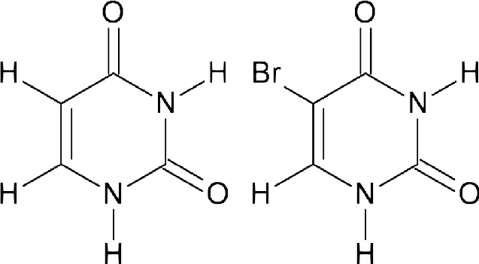
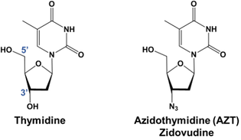
Uracil 5-bromouracil

Slide 7
1. Chemical DNA-Damaging Agents
iv. Intercalating Agents
Mechanism: Insert themselves between DNA base pairs, causing structural distortion.
Examples: Ethidium bromide, Doxorubicin
v. Reactive Oxygen Species (ROS)
Mechanism: Oxidize DNA bases, causing strand breaks and lesions.
Examples: Hydrogen peroxide (H₂O₂), superoxide anion (O₂⁻), hydroxyl radical (•OH).
Notes:
Doxorubicin is a widely used anthracycline antibiotic and chemotherapy drug
Ethidium bromide is a fluorescent intercalating agent primarily used in molecular biology for visualizing DNA and RNA in agarose

Slide 8
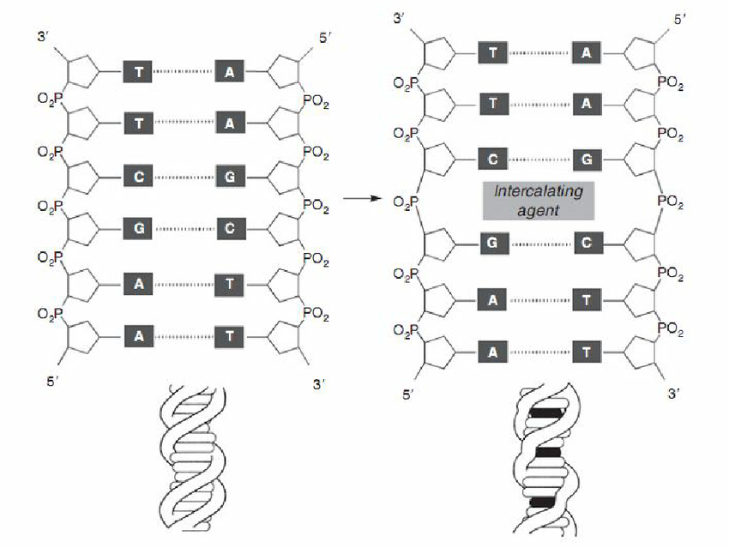

Slide 9
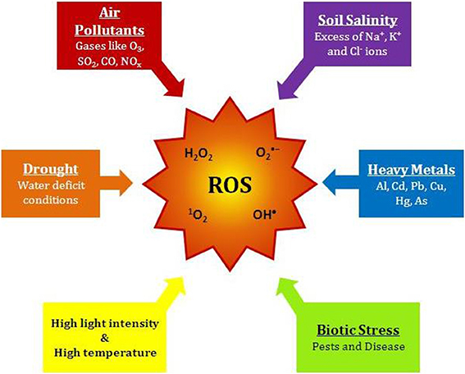

Slide 10
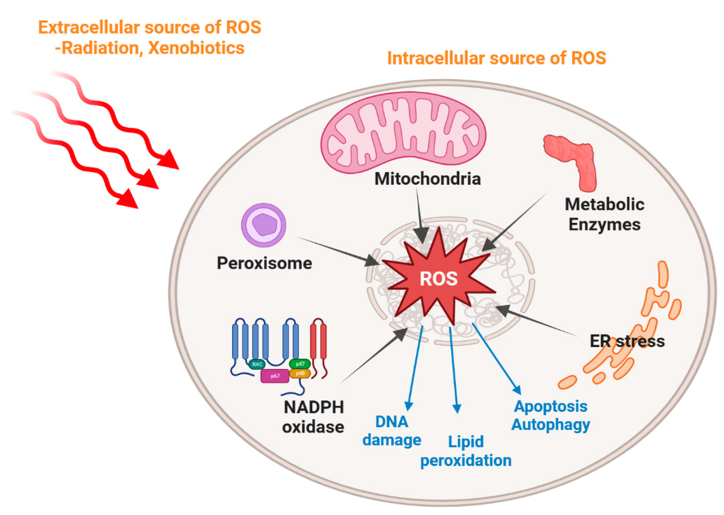
Notes:
Xenobiotics are foreign chemical substances not naturally produced or expected to be present in an organism, often introduced through drugs, pollutants, or dietary sources.

Slide 11
2. Physical DNA-Damaging Agents
Physical factors, particularly forms of radiation, can induce direct DNA breaks or ionize molecules to generate reactive species.
i. Ionizing Radiation
Mechanism: Causes single-strand or double-strand breaks and base damage.
Examples:
X-rays
Gamma rays

Slide 12
2. Physical DNA-Damaging Agents
ii. Ultraviolet (UV) Radiation
Mechanism: Induces pyrimidine dimers, mainly thymine-thymine dimers, which block DNA replication.
Examples:
UV-A, UV-B, and UV-C radiation.
iii. Heat
Mechanism: Causes deamination and DNA strand breakage.
Example: Prolonged exposure to high temperatures.

Slide 13
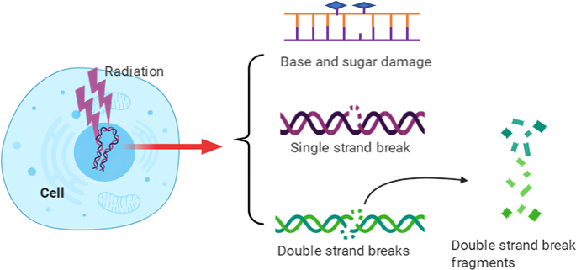

Slide 14
3. Biological DNA-Damaging Agents
These are factors produced by living organisms or biological processes.
i. Viral Infection
Mechanism: Some viruses integrate their genomes into host DNA or induce replication stress.
Examples:
Human papillomavirus (HPV)
Epstein-Barr virus (EBV)
Notes:
Epstein-Barr virus (EBV) is a herpesvirus that infects B cells and epithelial cells, often causing infectious mononucleosis (fever, sore throat, swollen lymph nodes, and fatigue) and associated with various cancers.

Slide 15
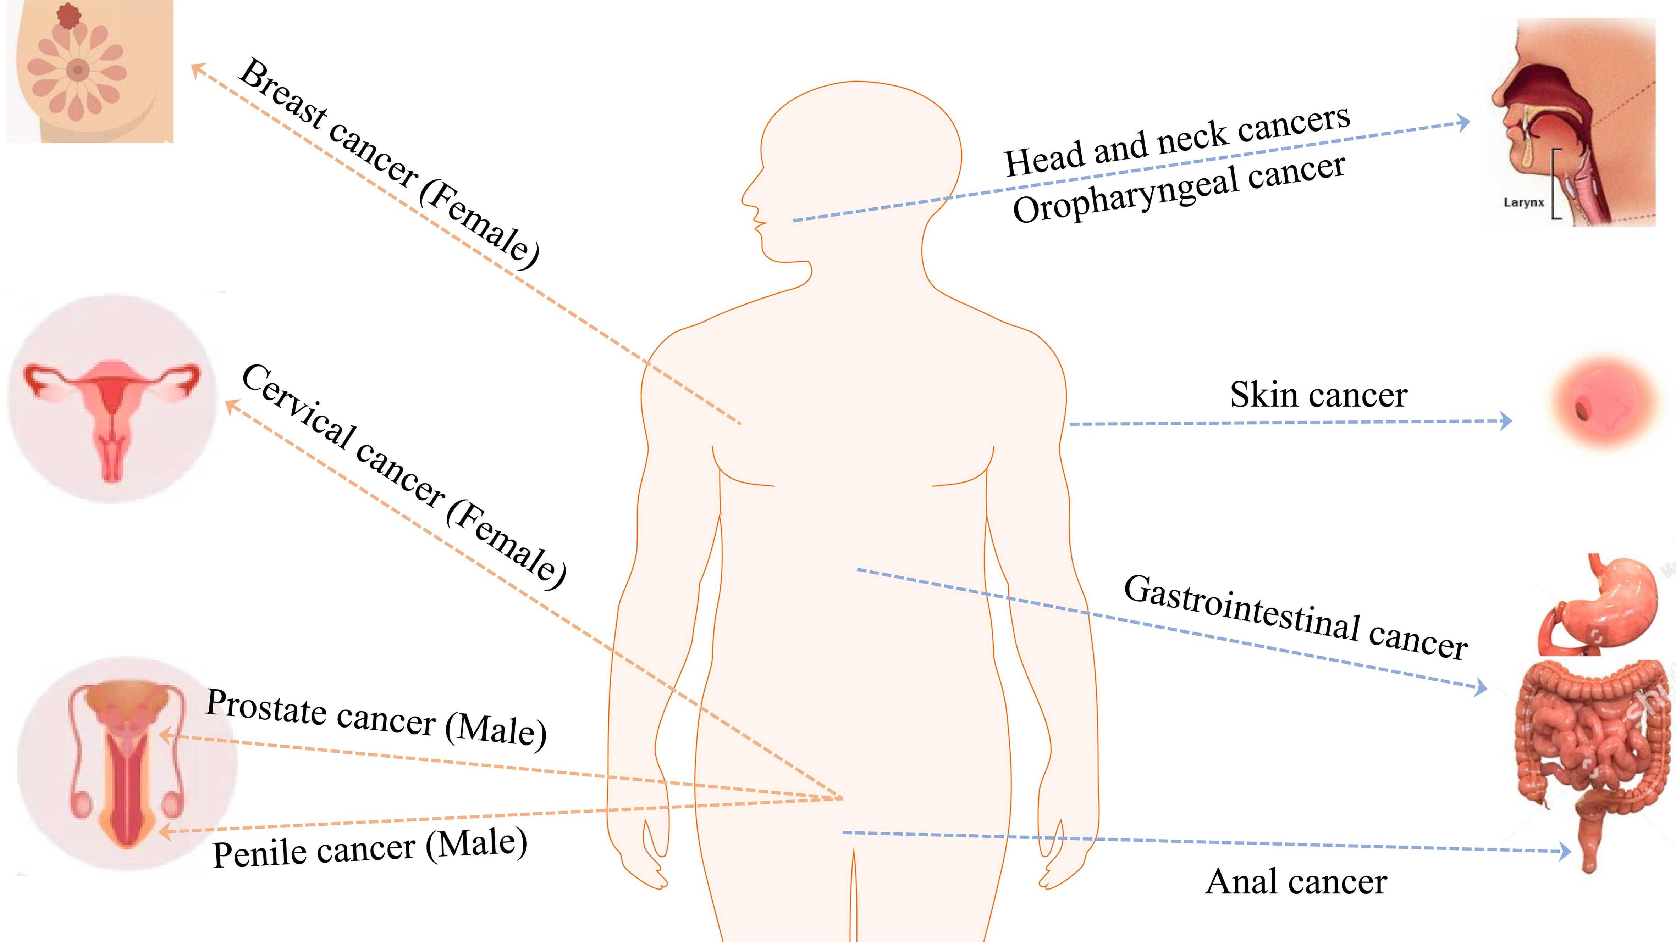
Effects of Human papillomavirus (HPV)

Slide 16
3. Biological DNA-Damaging Agents
ii. Endogenous Cellular Processes
Mechanism: Errors during replication or repair generate DNA lesions.
Examples: Replication stress and Spontaneous base deamination (e.g., cytosine to uracil)
iii. Bacterial Toxins
Mechanism: Induce DNA damage directly or via inflammation.
Examples: Colibactin (produced by Escherichia coli)
Notes:
Colibactin is a genotoxic metabolite produced by certain E. coli strains that is implicated in the development of colorectal cancer.

Slide 17
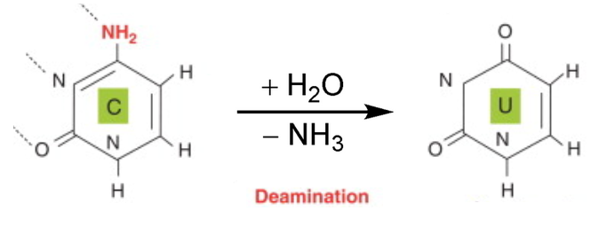
Cytosine Uracil

Slide 18
4. Environmental Agents
Agents present in the environment that damage DNA include pollutants, chemicals, and lifestyle factors.
i. Carcinogens
Mechanism: Form DNA adducts, induce strand breaks, or promote mutations.
Examples: Polycyclic aromatic hydrocarbons (PAHs), Benzene
ii. Heavy Metals
Mechanism: Disrupt DNA repair mechanisms and generate reactive species.
Examples: Arsenic, Cadmium
Notes:
DNA adducts are chemical compounds formed when reactive chemical species covalently bind to DNA bases, causing structural modifications. These adducts can result from exposure to carcinogens, pollutants, or endogenous reactive molecules.

Slide 19
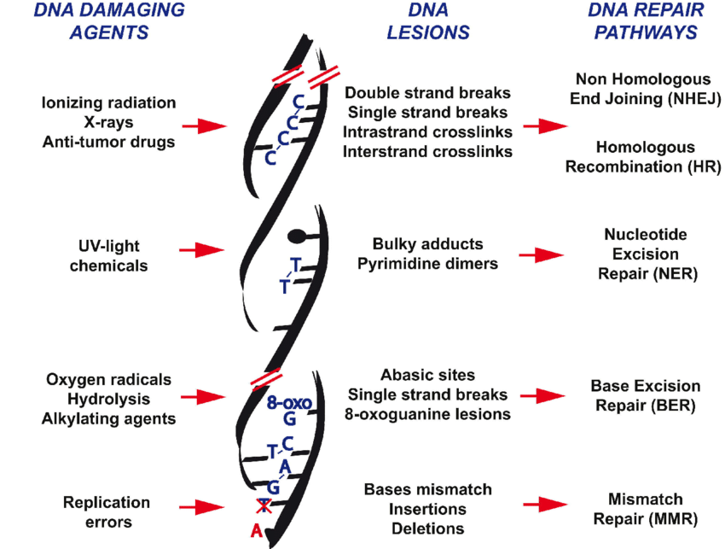

Slide 20
Consequences of DNA Damage
Cellular Effects:
Activation of DNA repair pathways (e.g., MMR, NER, BER, HR, NHEJ)
Cell cycle arrest
Apoptosis or senescence if damage is irreparable.
Long-term Effects:
Mutations leading to cancer
Genetic disorders
Aging related disorders

Slide 21


