Slide 1
SCIENCE PPT ON
CONSERVATION OF
NATURAL RESOURCES

Slide 2
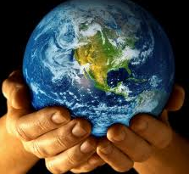
What are Natural Resources
Natural resources are the material which gifted by nature, and we use them as resources in our day to day life. Thus mining, petroleum extraction, fishing, hunting, and forestry are generally considered as natural-resource industries.

Slide 3
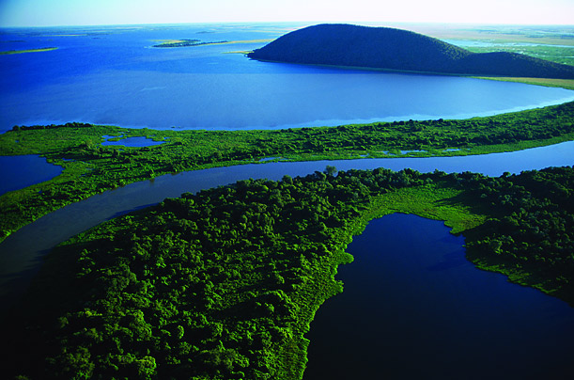
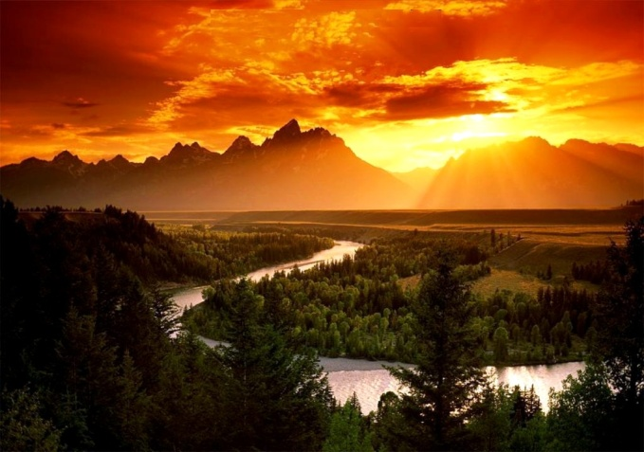
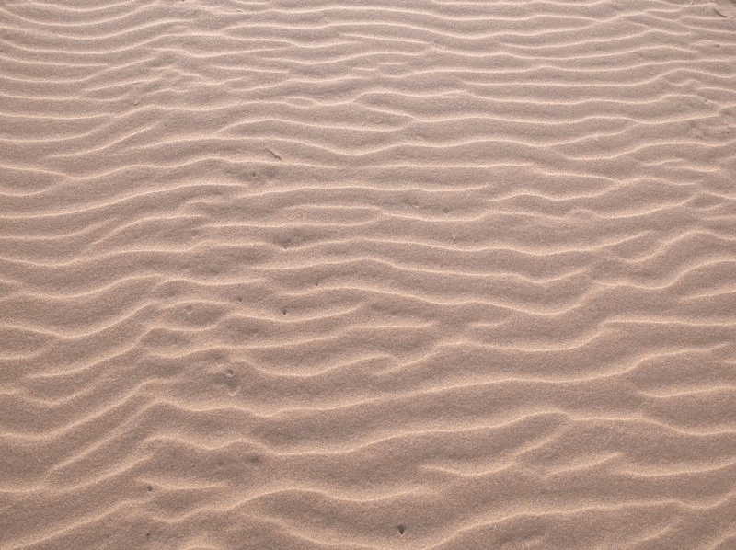
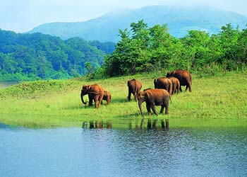
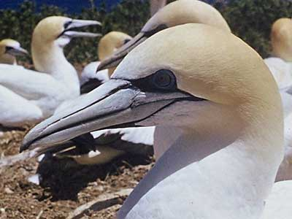
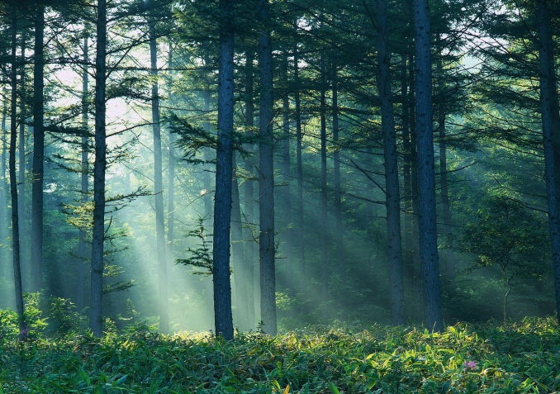
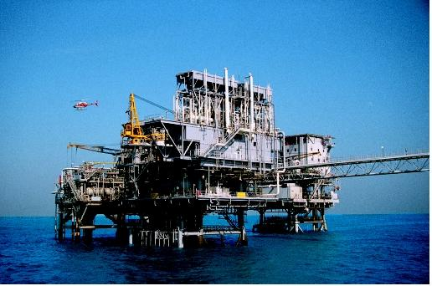
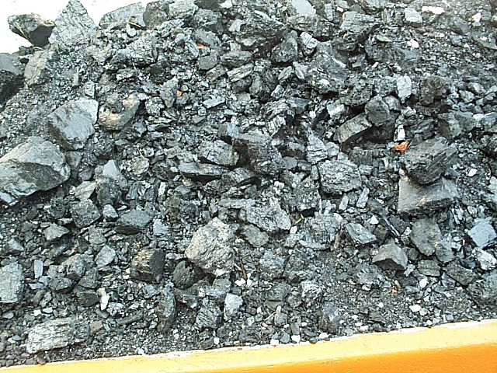
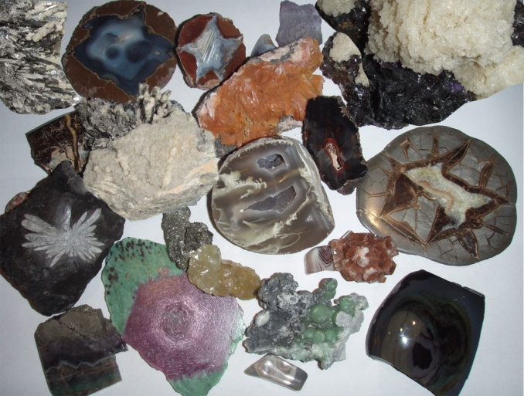
NATURAL RESOURCES

Slide 4

Importance of natural resources
Natural resources play a significant part in our lives. It will be really difficult to imagine the world without the natural resources. The globe without natural resources will be the as the globe without nature. The resources not only add to our lives, they serve the realm of progress.

Slide 5
NATURAL RESOURCES ARE OF TWO TYPES :-
RENEWABLE NATURAL RESOURCE
NON-RENEWABLE NATURAL RESOURCE
Those resources which can be replenished in a short period of time like air, water, sunlight, forests etc.
Those resources which cannot be replenished in a short period of time like minerals (coal, petroleum, natural gas, metals etc.) because they take millions of years to be formed.

Slide 6
CONSERVATION OF NATURAL RESOURCES
As the human population is continuously growing the consumption of natural resources is also increasing. With the increasing industrialization and urbanization of the modern human society, the use of all the resources is rising. If they are not properly used and well managed, a serious scarcity will result. Therefore we need to conserve the natural resources. This will also upset the ecological balance.
Conservation is the proper management of a natural resource to prevent its exploitation, destruction or degradation.
Conservation is the sum total of activities, which can derive benefits from natural resources but at the same time prevent excessive use leading to destruction or degradation.

Slide 7
Need for Conservation of Natural Resources
We know that nature provides us all our basic needs but we tend to overexploit it. If we go on exploiting the nature, there will be no more resources available in future.
There is an urgent need to conserve the nature. Some of the needs are :
to maintain ecological balance for supporting life.
to preserve different kinds of species (biodiversity).
to make the resources available for present and future generation.
to ensure the survival of human race.

Slide 8
Conservation of Natural Resources and Traditions of India
The need for conservation of natural resources was felt by our predecessors and in India, there was a tradition of respecting and preserving the nature and natural resources. Natural resources were conserved in the form of sacred groves/forests, sacred pools and lakes, sacred species etc. In our country the conservation of natural forests is known from the time of Lord Asoka. Sacred forests are forest patches of different dimensions dedicated by the tribal to their deities and ancestral spirits. Cutting down trees, hunting and other human interferences were strictly prohibited in these forests. This practice is wide spread particularly in peninsular, central and eastern India and has resulted in the protection of a large number of plants and animals and. Similarly, several water bodies, e.g., Khecheopalri lake in Sikkim was declared sacred by people, thus, protecting aquatic flora and fauna. Worshipping certain plants like banyan, peepal, tulsi etc. has not only preserved them but also encouraged us for their plantation. History recalls numerous instances where people have laid down their lives in protecting the trees.
Recent Chipko movement in India is one of the best examples. This movement was
started by the women in Gopeshwar village in Garhwal in the Himalayas. They
stopped the felling of trees by hugging them when the lumbermen arrived to cut
them. This saved about 12000 square kilometers of the sensitive water catchment
area. Similar movements also occurred in some other parts of the country.

Slide 9
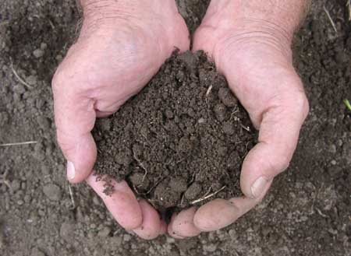
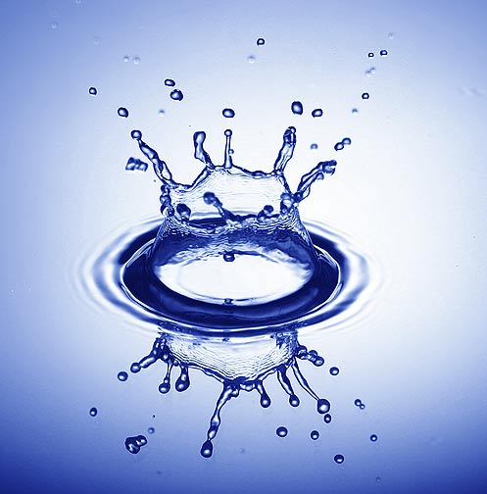
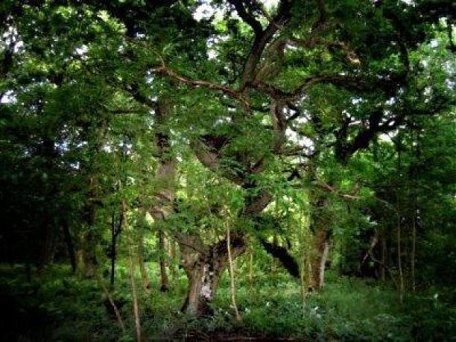
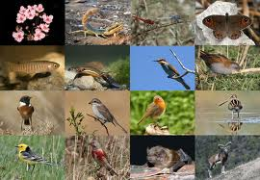
As a Responsible Citizen
We have to conserve mainly
Soil
Water
Forests
Biodiversity

Slide 10

Some of the
Methods to Conserve our
basic Natural Resources

Slide 11
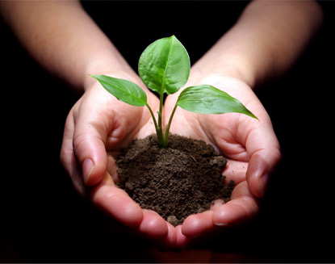
Conservation of Soil
In the previous section we learnt about the various causes of soil erosion. Soil loses its fertility due to erosion. So we need to conserve the soil. Soil conservation means checking soil erosion and improving soil fertility by adopting various methods. Let us know some of these methods.
1. Maintenance of soil fertility: The fertility can be maintained by adding manure and fertilizers regularly as well as by rotation of crop.
2. Control on grazing: Grazing should be allowed only on the areas meant for it and not on agricultural land.
3. Reforestation: Planting of trees and vegetation reduces soil erosion by both water and wind.
4. Terracing: Dividing a slope into several flat fields to control rapid run of water. It is practiced mostly in hilly areas.
5. Contour ploughing: Ploughing at right angles to the slope allows the furrows to trap water and check soil erosion by rain water.

Slide 12
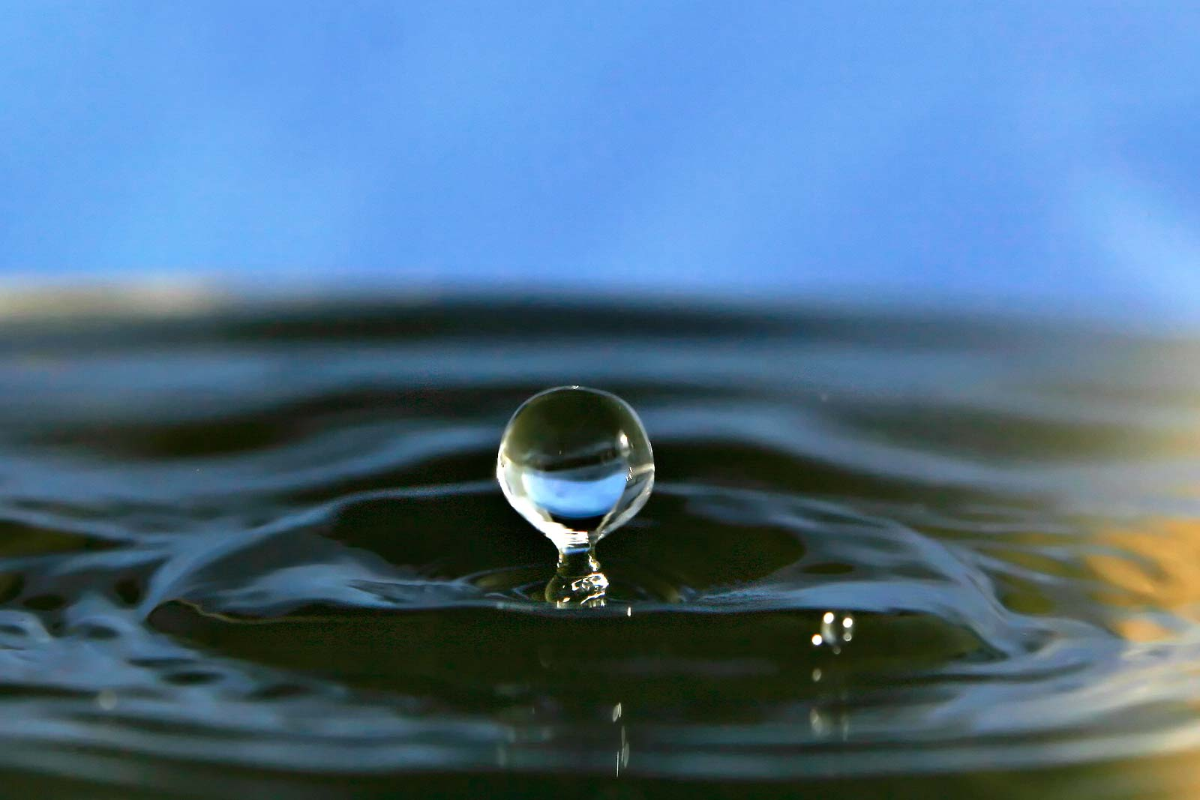
Conservation of Water
Conservation and management of water are essential for the survival of mankind, plants and animals. This can be achieved adopting the following methods:
1. Growing vegetation in the catchment areas, which will hold water in the soil and allow it to percolate into deeper layers and contribute to formation of ground water.
2. Constructing dams and reservoirs to regulate supply of water to the fields, as well as to enable generating hydroelectricity.
3. Sewage should be treated and only the clear water should be released into the rivers.
4. Industrial wastes (effluents) should be treated to prevent chemical and thermal pollution of fresh water.
5. Judicious use of water in our day-to-day life.
6. Rainwater harvesting should be done by storing rainwater and recharging groundwater.

Slide 13
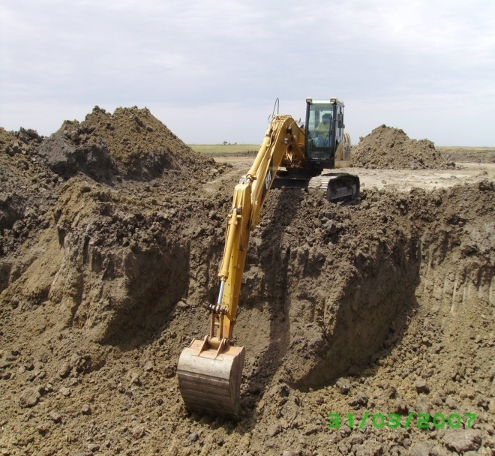
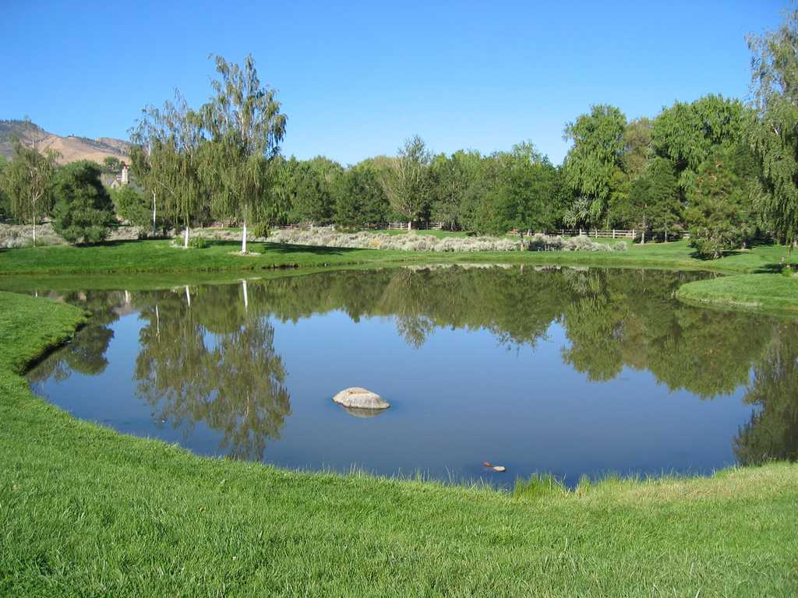
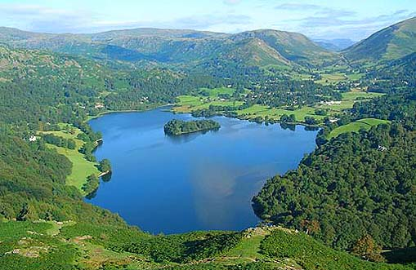
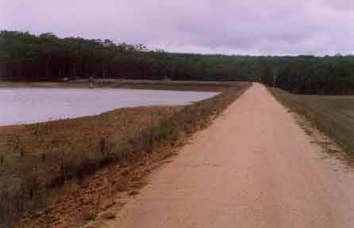
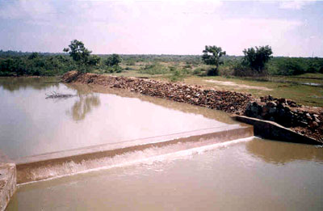
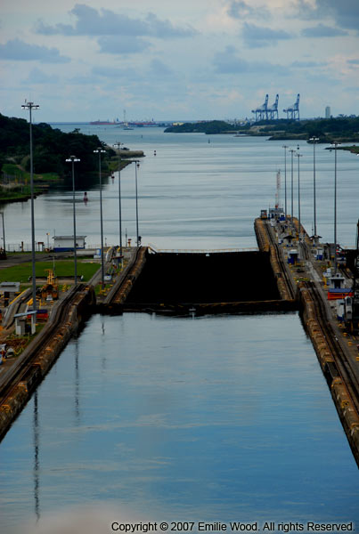
Different methods of water harvesting

Slide 14
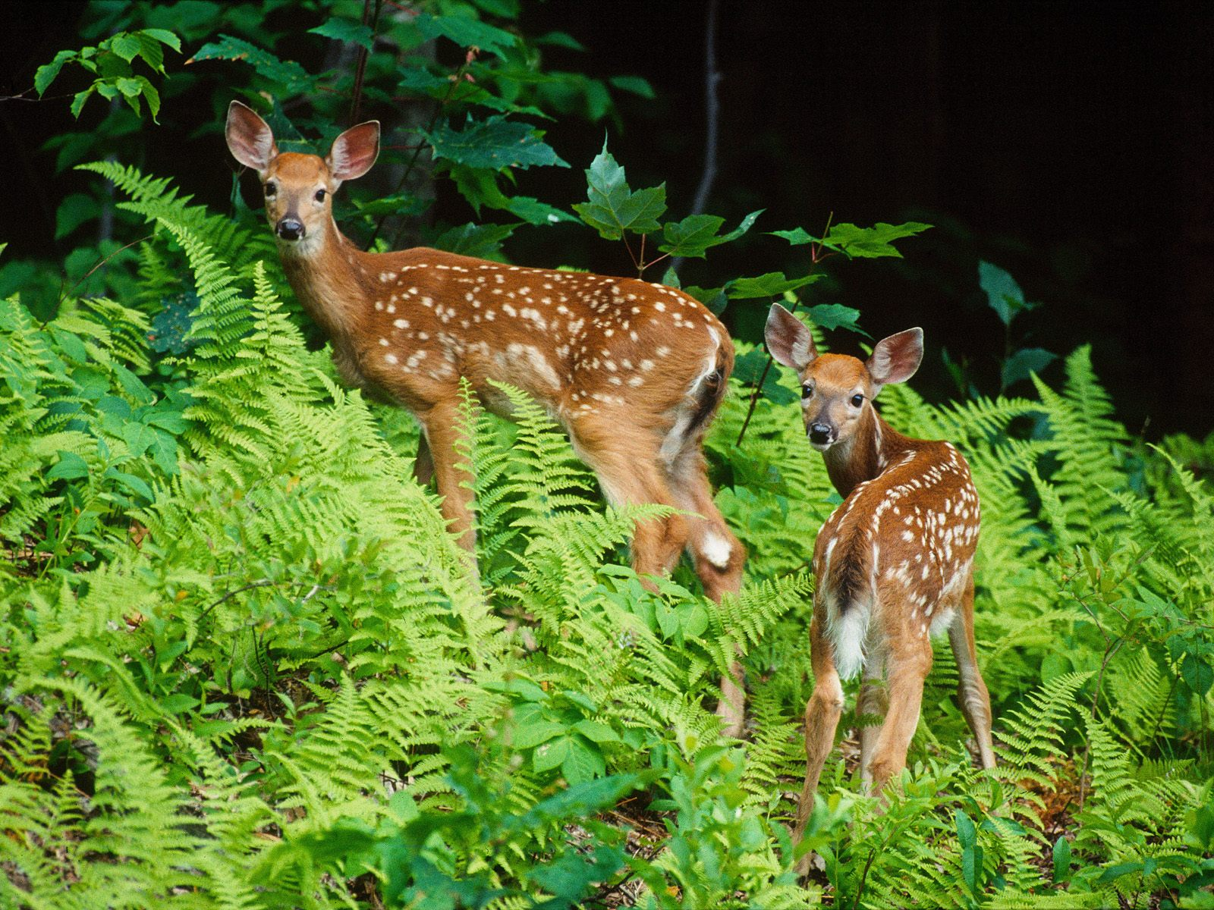
Conservation of Biodiversity
Now you have an idea of the importance of biodiversity for our survival and how it is destroyed. Let us know how to protect the biodiversity. There are two basic strategies for conservation of biodiversity:
(i) In-situ conservation
(ii) Ex-situ conservation
(i) In-situ (on site) conservation includes the protection of plants and animals
within their natural habitats or in protected areas. Protected areas are areas of land or sea dedicated to protection and maintenance of biodiversity. For example: e.g., National Parks, Wildlife Sanctuaries, Biosphere Reserves, etc.
(ii) Ex-situ (off site) conservation is the conservation of plants and animals outside their natural habitats. These include Botanical Gardens, Zoo, Gene Banks, DNA Banks, Seed Banks, Pollen Banks, Seedling and Tissue Culture etc.

Slide 15
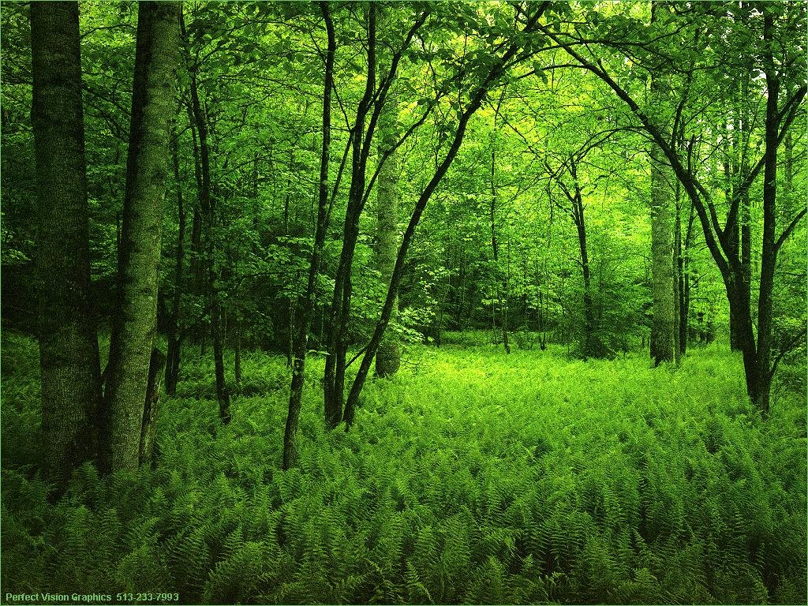
Conservation of Forests
Forests is an important part of the environment, because trees clean the air and keep the atmosphere cool. We cannot live without plants, because the oxygen need for breathing is produced by plants.
Trees absorb sunlight and reduce the heat. Plants provide fodder for animals, firewood, timber, medicines, honey, wax, gum, lac and food for us. Tree roots penetrate deep into the soil and from cavities in the ground. The dry leaves which fall on ground, cover the soil and absorb more rain water, which slowly percolates through the soil. Thus, a large portion of the rain water can be retained in the field, by planting more trees. Flooding or rivers can be prevented by protecting trees in the forest.

Slide 16
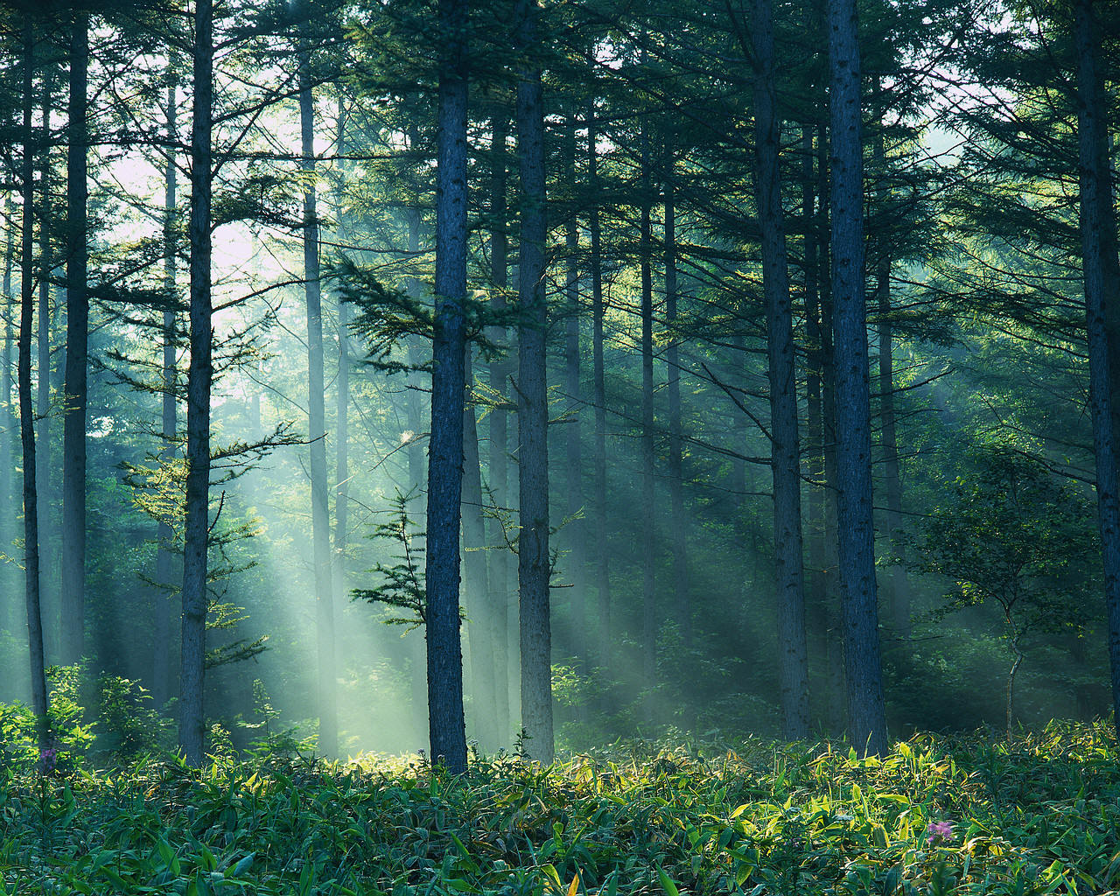
For the conservation of forests, following methods can be taken:
(a) Conservation of forest is a national problem so it must be tackled with perfect coordination between forest department and other departments.
(b) People's participation in the conservation of forests is of vital importance. So, we must get them involved in this national task.
(c) The cutting of trees in the forests must be stopped at all costs.
(d) Afforestation or special programmes like Van Mahotsava should be launched on grand scale.
(e) Celebrations of all functions, festivals should precede with tree-plantation.
(f) Cutting of timber and other forest produce should be restricted.
(g) Grasslands should be regenerated.
(h) Forest conservation Act 1980 should be strictly implemented to check deforestation.
(i) Several centres of excellence have been setup and awards should be instituted.

Slide 17
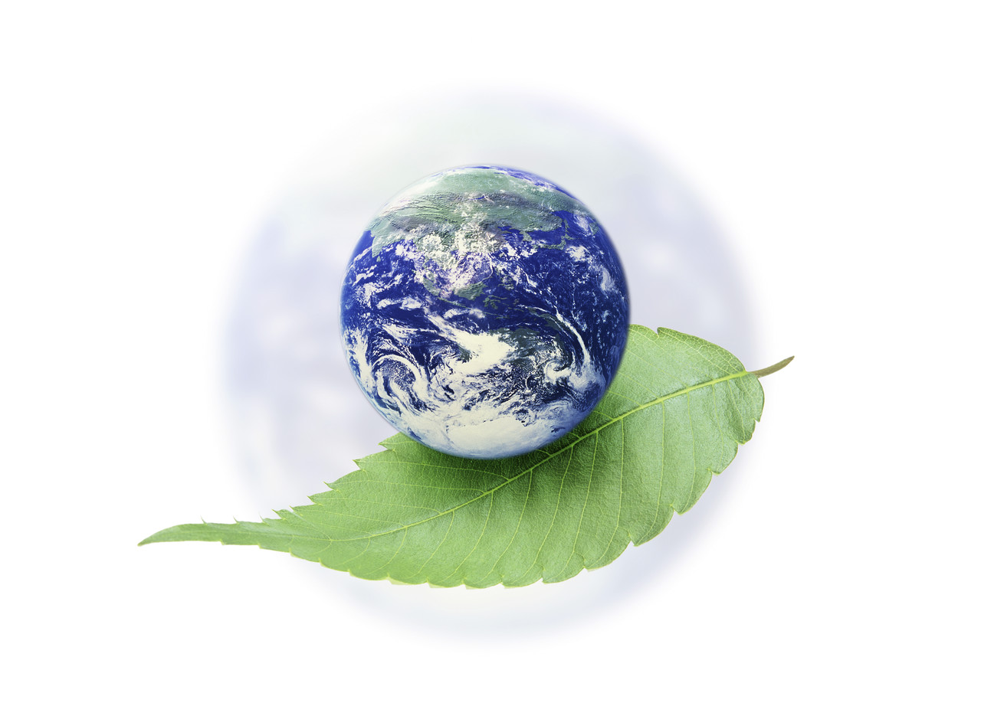
What is Environment?
Our Environment is our surrounding. This includes living and non-living things around us. The non-living components of environment are land, water and air. The living components are germs, plants, animals and people. All plants and animals adjust to the environment in which they are born and live. A charge in any component of the environment may cause discomfort and affect normal life. Any unfavorable change or degeneration in the environment is known as ‘Environmental Pollution.
We need to protect our environment to live happily.

Slide 18



How to Maintain a Good Environment?
For better environment, all its components should be protected from pollution and the surroundings should be clean. We need to take good care of our land, water resources, forests and atmosphere . it is also necessary to ensure a balance between these resources and living creatures, to meet our needs.

Slide 19

We can protect our environment in many ways. Let us act now and persuade others to join us. This will ensure safety for our future generations.

