Slide 1
Identification of Spiders

Slide 2
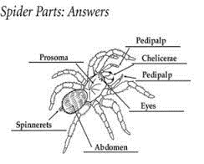
Parts of a spider

Slide 3
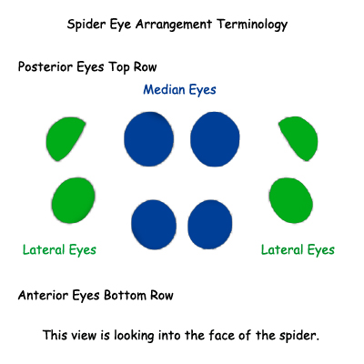
How to identify spiders??
The eye arrangement can be a key factor when identifying spiders to family, and sometimes to genus, but are almost never useful in identifying to species

Slide 4
Families with no. of eyes
Families with six-eyed spiders
Anapidae (in part)
Cybaeidae (in part-nearly all eight-eyed)
Dictynidae (in part-nearly all eight-eyed)
Diguetidae
Dysderidae
Leptonetidae (in part-nearly all six-eyed)
Linyphiidae (in part-nearly all eight-eyed)
Nesticidae (in part-nearly all eight-eyed)
Ochryroceratidae
Oonopidae (in part-nearly all six-eyed)
Orsolobidae
Pholcidae (in part)
Scytodidae
Segestriidae
Sicariidae
Telemidae (in part-nearly all six-eyed)
Families with four-eyed spiders
Nesticidae (in part)
Symphytognathidae
Families with two-eyed spiders
Caponiidae
Families with no-eyed spiders
Cybaeidae (in part-nearly all eight-eyed)
Dictynidae (in part-nearly all eight-eyed)
Leptonetidae (in part)
Linyphiidae(in part-nearly all eight-eyed)
Nesticidae (in part)
Telemidae (in part-nearly all six-eyed)
Theridiidae (in part)
Families with eight eyed spiders
Agelenidae
Amaurobiidae
Anyphaenidae
Clubionidae
Corinnidae
Ctenidae
Ctenizidae
Cybaeidae
Dictynidae
Filistatidae
Gnaphosidae
Linyphiidae
Lycosidae
Mimetidae
Miturgidae
Oecobiidae
Oxyopidae
Philodromidae
Pholcidae
Pisauridae
Salticidae
Selenopidae
Sparassidae
Thomisidae
Tetragnathidae
Theridiidae

Slide 5
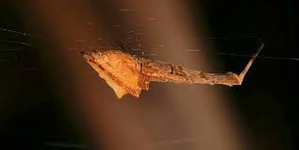
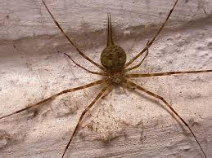
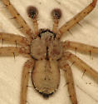
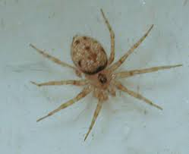
Some common families
Pholcidae
Aranidae
Tetregnathidae
Oxyopidae
Lycosidae
Hersiliidae
Thomisidae
Salticidae
Gnaphosidae
Oecobiidae
Selenopidae
Uloboridae

Slide 6
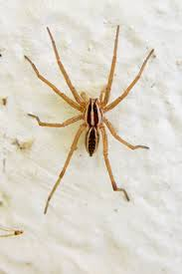

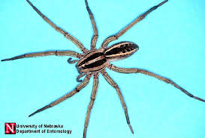
Lycosidae (Wolf Spider)

Slide 7
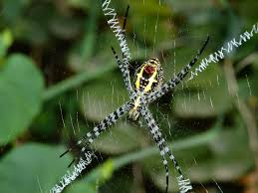
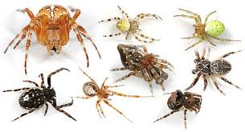

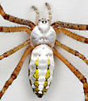
Aranidae (Orb weavers)

Slide 8
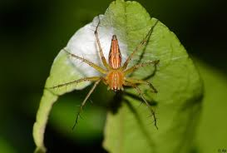
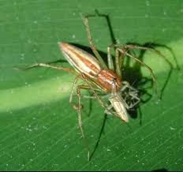

Oxyopidae (lynx spider)

Slide 9
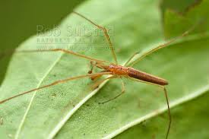
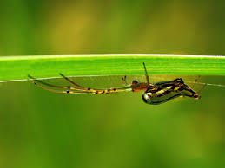

Tetregnathidae (long jawed orb weavers)

Slide 10
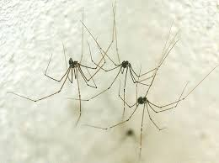

Pholcidae (Cellar spider)

Slide 11
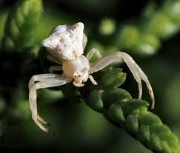
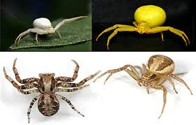
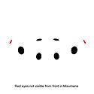
Thomisidae (Crab spiders)

Slide 12
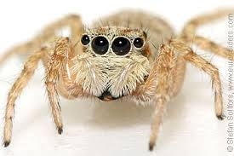
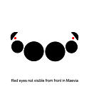
Salticidae (Jumping spiders)

Slide 13

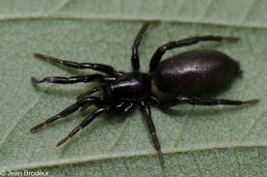
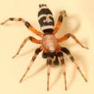
Gnaphosidae (Ground spider)

Slide 14
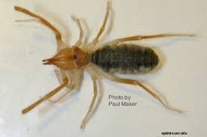
Camel spider: not a spider….

