Slide 1
Zoogeographical regions
Course code: ZOOL-15204

Slide 2
ZOOGEOGRAPHY
Zoogeography is the study of animal distributions.
I. Descriptive (Ecological) Zoogeography:
The study of local and global distributions of living species relative to their environments.
II. Historical Zoogeography:
The study of originations, extinctions, and migrations over time (often includes looking at fossil species).

Slide 3
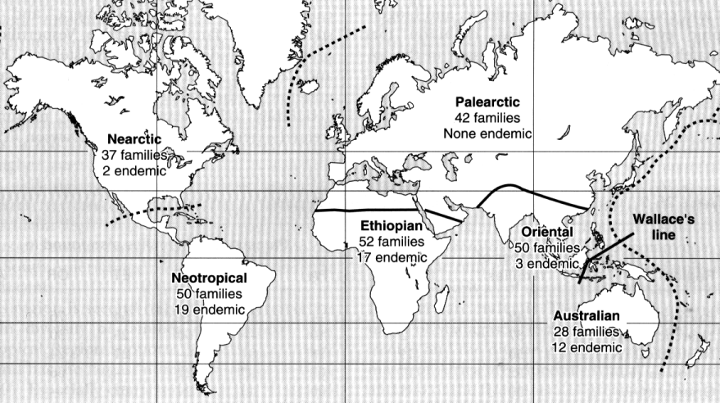
The world can be divided up into six zoogeographic regions (proposed by Wallace, 1876).

Slide 4
Palearctic Region
Largest zoological region that includes whole Europe, North part of Africa, Northern part of China, USSR, Japan, Iran, Afghanistan and Baluchistan of Pakistan.
1 ) This region shows wide range of temperature fluctuations.
2) It also shows wide range of fluctuation in the amount of rainfall.
3) It includes polar arctic region.
4) On its Northern side it shows temperate conditions
5) Eastern Asia shows deciduous forests.
6) In the Northern region ‘Steppe’ grass lands are present.

Slide 5
Fauna of Palearctic region
There are following animals in this region:
Mammals: There are 28 Families of mammals.
Moles
shrews,
rabbits,
hedgehogs,
squirrels,
porcupines,
camels,
Donkeys,
Cat
Dogs
Deer
Bear
Sheep
Oxen
Two families are unique to this region i.e.
Spalacidae (Genus Spalax)
Selevinidae (Genus Selevinia)

Slide 6
Birds:
Hawks
Ducks
Cuckoos
Kingfishers
Blackbirds
Finches
Thrushes
Storks
Loons
Grebes
There are no parrots.
The accentors (Family Prunellidae) is endemic to the Palearctic region

Slide 7
Reptiles:
Turtles
Tortoise
few lizards and
Snakes
Alligator present only in China
Amphibian:
Tailed amphibians: newts and salamander
Frogs and tree frogs
Toads

Slide 8
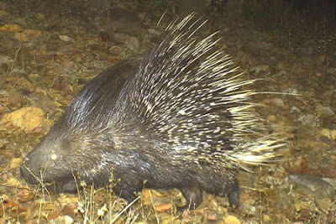
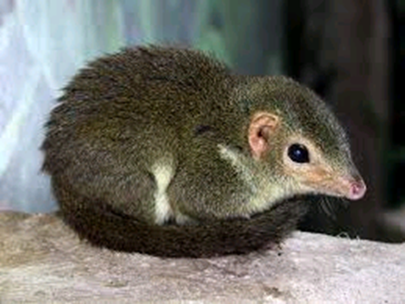

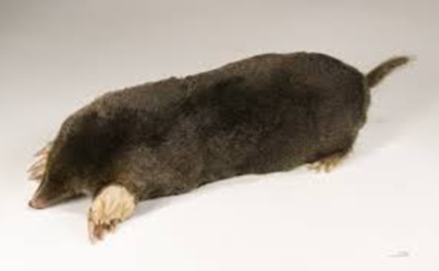
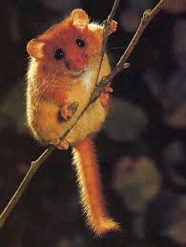
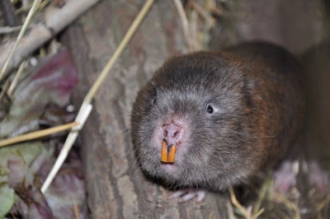
Hedgehog
Porcupine
Shrew
Mole
Selevinia
Bamboo rat (Genus Spalax)

Slide 9
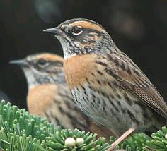
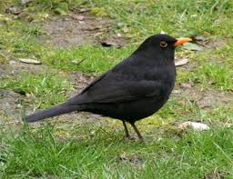
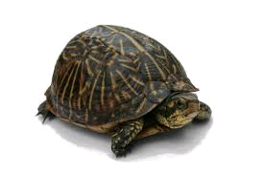
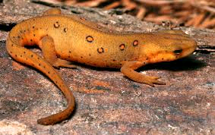
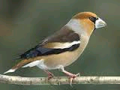
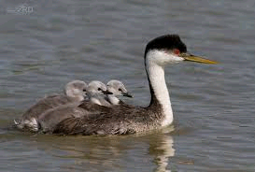
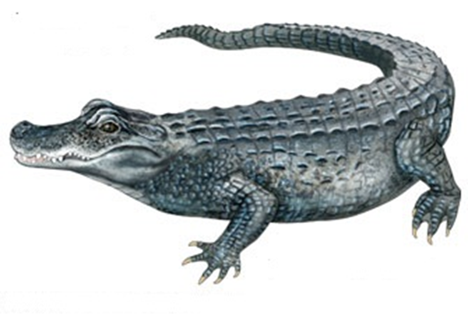
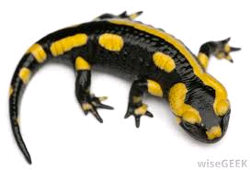
Turtle
Accentors
Black bird
Newt
Finches
Grebes
Salamander
Crocodile

Slide 10
Oriental region
Geographic Limits of Oriental Region
The region includes almost all the tropical parts of Asia. Himalaya forms a well-marked boundary in the north but in north east it is not so clearly marked because some animals of Palaearctic Region are further traceable to south and similarly the dispersal of some Oriental animals occurs northwards. The Southern limits are those of continent including the Greater Sunda Islands (Sumatra, Borneo, Sulawesi and Java) and Sri Lanka. In the east boundary is vague and not clearly marked and the opinions are uncertain. About the western boundary opinions are different because desert fauna of Africa and Arabia is traceable to the Sind and Rajasthan.

Slide 11
Mammals
There are 33 families of mammals which only 4 are endemic to this region.
Tree shrews (Tuaiidae) are restricted to the Oriental Region inhabiting India but not reaching the Sri Lanka, then spreading eastwards to the Greater Sunda Islands and Philippines. These are represented by six genera and many species. Their ancestral history is unknown. The most primitive genus is Ptilocerus (Pen-tailed Tree Shrews) of family Ptilocercidae. It is only known from the Malaya, Sumatra, Banka and Borneo.

Slide 12
Gibbons of Family Holobatidae are restricted to Oriental Region. The highly specialized is Hylobates syndactylus, known only from the mountains of Malaya and Sumatra. Sensu stricto is represented by many subspecies in Java, Borneo, Sumatra, Malaya, Siam, Assam, Bhutan, and Vietnam. Ancestors of gibbons lived in Europe up to Pliocene times, since they also occurred in Siwaliks.
Lemurs, the Galeopithicus, only 3 species of this flying Lemur are present extending from South China through Burma, Thailand and Malaya to Greater Sunda Islands and restricted to this region only.

Slide 13
Tarsius is another relict, only few species are known. All are nocturnal and arboreal. They are present in the forests of Java, Sumatra, Bali, Banka and Biliton and are also found in Celebes and Philippines. Their ancestor lived in forests of North America and Europe during and after lower Eocene.

Slide 14
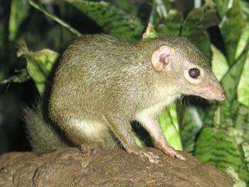
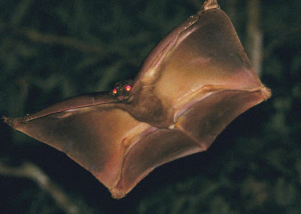
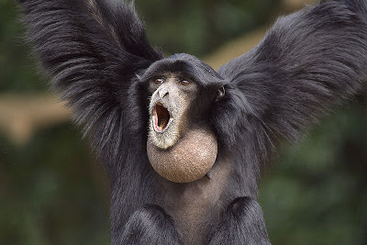
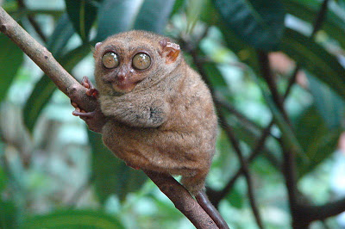
Tree Shrews
Flying lemur
Gibbon
Tarsier

Slide 15
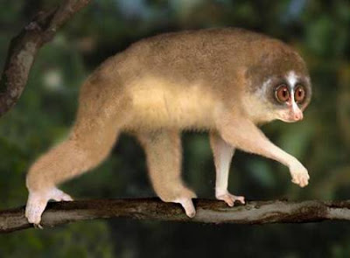
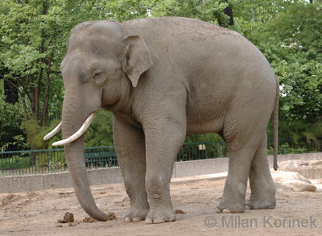
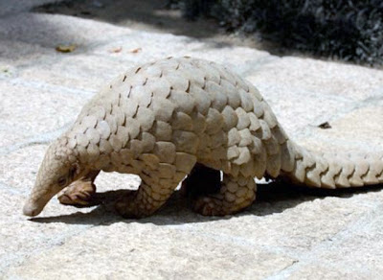
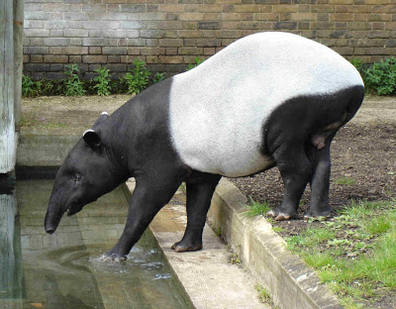
Loris
Elephant
Pangolin
Tapir

Slide 16
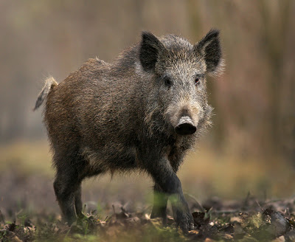
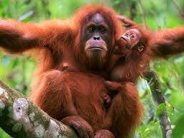
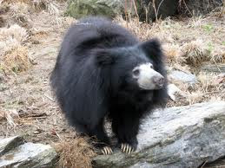
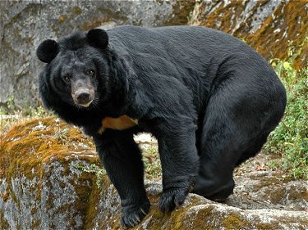
Orang Utan
Himalayan Black bear
Wild Boar
Sloth Bear

Slide 17
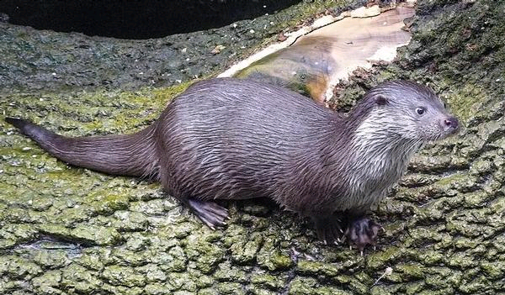
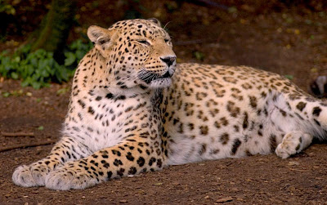
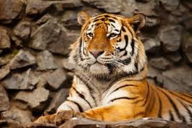
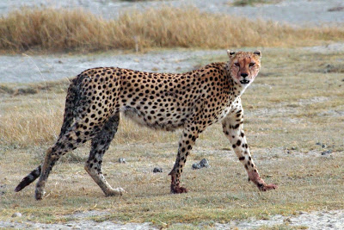
Otter
Panther
Tiger
Cheetah

Slide 18
Birds
There are 66 families of birds. Broadbills-endemic
Among these Bee-eaters are numerous and they all belong to family Meropidae. They are also present in Ethiopian region but very few in Palaearctic.
The Rollers (Coraciidae) are represented in Oriental region by two genera, Coracias and Eurystomus only in Asia. They range from India northward to China, and eastwards to Australia and Solomon Islands.
The Bulbuls (Pycnonotidae) are most abundant in Oriental region, spreading northwards to China, Hainan, Formosa, and Japan and eastwards to Moluccas.
Many pigeons and large number of parrots are present.

Slide 19
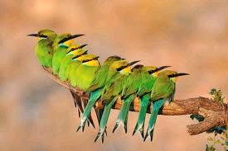
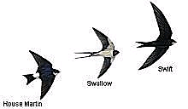
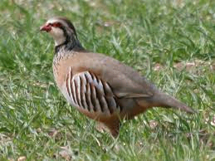
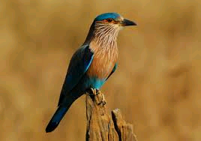
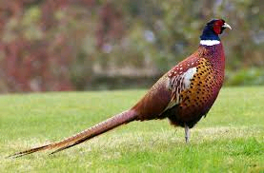
Bee eaters
Grey Partridge
Indian Roller
Ring necked pheasant

Slide 20
Reptiles
A large number of freshwater tortoise of family Platysternidae are exclusively present. Crocodiles of genus Crocodilus and Gavialis are also exclusive.
Lanthanotus (family Helodetermatidae, Gila monsters) are exclusively present in Borneo. Others are geckos, chameleons, agamids, and varanuses.
Poisonous snakes are only present in Oriental region and these belong to all subfamilies. Cobra, krait, vipers are very common in India, Sri Lanka, Burma, Thailand and Java. Boidae family having python is also present. The less dangerous snakes Opisthoglypha(back fanged snakes) are represented by Dipsadomorphinae, Elachistodontinae and Homalopsinae. Pteroglypha are represented by sub-family Elapinae among which Krait (Bungarus coeruleus) and cobra (Naja tripendians) are well known.
Among Viperinae, Russell’s viper (Daboia russelii) from India, Sri Lanka, Burma, Siam and Java is most dreadful of all. Except for Elachistodontinae and Homalopsinae, none of these subfamilies are restricted to Oriental region. Uropeltidae and Xenopeltidae family of nonpoisonous snake are endemic.

Slide 21
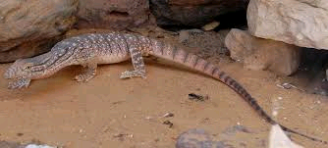
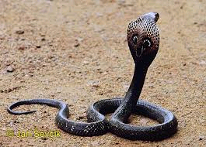
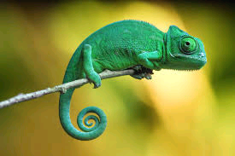
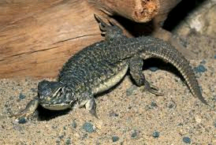
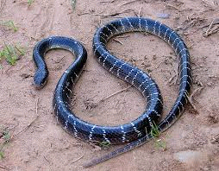
Chameleon
Cobra
Varanus
Uromastix
Krait

Slide 22
Amphibians
Amphibians are represented by many apoda and anura but Urodela (tailed amphibians) are absent. Paleobatidae family including spade foot toads is present in Oriental region but they are also present in Europe and North America yet absent from Sri Lanka.
The true toads are almost cosmopolitan but absent from Madagascar. The allied genus Pseudobufo is restricted to Malay Peninsula, Java Sumatra and Borneo.
Tree frogs are absent from Oriental region but one species has been recorded from northern Columbia. True frogs belong to family Ranidae are well represented in this region. They probably originated in northern hemisphere and spread southwards and until they reached northern part of Australia, Madagascar and northern part of South America.
Rhacophoridae (old world tree frog) is adapted to arboreal mode of life and all the members possess adhesive disc at fingers. Although numerous are in Ethopian region, certain are in Oriental. A few caecilians (legless) and salamanders are also present.

Slide 23
Fishes
Oriental fauna does not include the primitive fishes (Archaic group). It is dominated by Carps and catfishes in rivers, lakes and ponds. Cyprinines are also abundant. Pangasidae and Chacidae are endemic.
Three families of catfishes are common with Ethopian region. These are Bagridae, Schilbeidae, Clariidae with exception of Clarias genus, the Ethopian and Oriental region are all different.
Labyrinth fish which can live without water due to labyrinth like organ with gill chamber are characteristics of Oriental region. Although few species are found in Africa also one of the best known such fish is gourami (osphronemus gouramy) anabus splendens(climbing perch) is well represented and also found in Ethopian region.
The opisthomi is a small order including eel like freshwater fishes. In Oriental region three genera belonging to Opisthomi are found, these are Chaudhuria, Rhynchobdella, and Mastacembelus. Mastacembelus has also a number of species in the Ethopian fauna.

Slide 24
Ethiopian region
Africa, Sahara desert, Southern part of Arabia, Madagascar Island are included in this region.
Mammals in Ethiopian region:
1. Aye aye (Hyaena),
2. Galeopithicus,
3. Gorilla gorilla,
4. Chimpanzee,
5. Gibbon,
6. Equs equs (Horse),
7. Elephant,
8. Panthera tigris (Tiger),
9. Panthera leo ( lion),
10. Assionomyx (Leopard),
11. Camelus (Camel),
12. Deer,
13. Sus (Pig),
14. Equs acinus (Donkey).

Slide 25
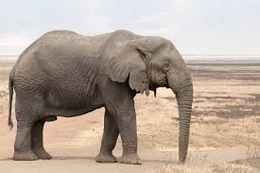
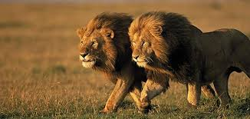
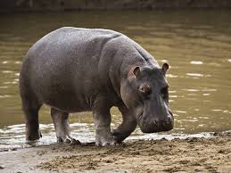
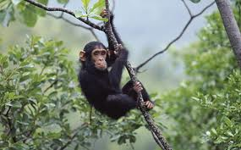
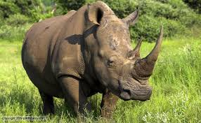
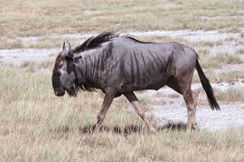
Elephant (loxodonta)
Lions
Chimpanzee
Hippopotamus
Rhinoceros

Slide 26
Birds in Ethiopian region : The most important birds of this region are two toed Ostrich- Struthio camelus.
1. Horn bills,
2. Heron,
3. Pigeons,
4. Parrot,
5. Cuckoos,
6. Storks,
. Finches etc.,
In this region some exclusive birds are present. They are.
1. Ostriches,
2. Pittedae,
3. Hammer headed birds, Mouse birds etc.

Slide 27
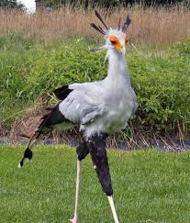
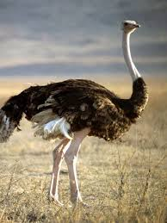
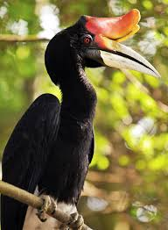
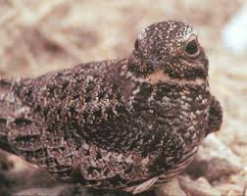
Secretary bird
Ostrich
Hornbill
Goat Suckers (Nightjars)

Slide 28
Reptiles in Ethiopian region : Crocodiles and Reptiles are very numerous.
1. Testudo,
2. Trionyx,
3. Chamaeleon. Itis the char-acteristic of this region.
4. Geck. It is a flying lizard. In this region many Snakes are present.
1. Rattle snakes,
2. Cobras,
3. Vipers,
4. Pythons,
5. Typhiops etc., are common in this region.

Slide 29
Amphibians in Ethiopian regions: This fauna is distinctive, It is represented by Cicaelians, Anura.
1. Rhacophorus,
2. Hyla,
3. Microhyla,
4. Xenopus (Clawed Toad). It is exclusively in this region.
5. Cicaeans are abundant.
6. Tailed amphibians are absent.

Slide 30
Fishes in Ethiopian region: Fish fauna is diverse.
1. Protopterus African fresh water lung fish is seen in this region,
2. Sharks,
3. Tuna fishes,
4. Cat fishes,
5. Cyprinids,
6. Electric fishes are common in this region.

Slide 31


Slide 32
Australian region
Australian region contains Australia, New Zealand, New Guinea and nearby Islands in the Pacific ocean
Partly tropical, partly temperate climate

Slide 33
134 families of terrestrial vertebrates
30 endemic families
    8 endemic families of mammals
    17 endemic families of birds
    3 endemic families of reptiles
    2 endemic families of amphibians
Variety of primitive forms so also known as “Veritable museum of Archaic animals”

Slide 34
Mammals
9 families (apart from bats)
Monotremes (egg-laying mammals):
  Duck-billed Platypus
  Echidna (Spiny ant eater)
Marsupials (Pouched mammals):
  Kangaroos
  Wallabies
  Bandicoots
  Phalangers
  Koalas
  Wombats
Placental mammals:
  Murid mouse

Slide 35
Birds
Vast diversity present
10 unique families
Running birds (Ratites) present:
  Emu
  Cassowary
  Kiwi
Honey suckers
Lyre bird
Bower bird
Bird of Paradise
Tooth-billed pigeons
Parrots: three exclusive sub-families
  Pygmy parrots
  Cockatoos
  Lories
Trogons
Cuckoos
Kingfisher
Honey-eaters

Slide 36
Reptiles
Moderately varied reptilian fauna
250 species of small lizards
Large lizard: Komodo dragon
Crocodiles
Two exclusive families:
  Scale footed lizard
  Fly river turtle
Amphibians
No toads and tailed amphibians
Tree frogs and common frog in abundance-about 100 species
Fish
Australian lung fish: Neoceratodus

Slide 37








Kangaroo
Phalanger
Koala
Wombat
Murid mouse
Possum
Numbat
Wallaby

Slide 38






Emu
Cockatoo
Pygmy parrots
Bird of Paradise
Kiwi
Cassowary

Slide 39




Komodo dragon
Scale footed lizard
Fly river turtle
Tree frog

Slide 40
Neotropical region
This region includes South America, Central America, Mexico and West Indies.
This region shows tropical conditions. The southern part of South America shows temperate zones, because of these varied environmental conditions Luxuriant forests, Deserts, Plains and Rivers are common.
1) In the Amazon region thick forests are present. They are all evergreen forests.
2) Grassy plains present in Argentina.
3) This region shows Mountains. Because of these conditions good vegetation is seen and rich fauna is present.

Slide 41
155 families of terrestrial vertebrates
39 endemic families
Mammals:
32 families (excluding bats)
  16 endemic
Order Xenarthra is endemic and represented by the following three families:
  Sloths
  Anteaters
  Armadillos
Two families of marsupials:
Caenolestidae
Opossum

Slide 42






Ant eater
Armadillo
Sloth
Opossum
Caenolestidae
Llama

Slide 43
Mammals
Monkeys are brilliantly coloured and diverse.
Smaller in size with most of them a little larger than a squirrel
Flat nose
Prehensile tail
Belong to two families:
  Cebidae
  Callithricidae
11 endemic families of rodents
5 indigenous species of bats including vampire bats
Tapir (also found in Malayan region)
Llama (endemic), Camellidae family

Slide 44


Family Cebidae
Family Callitrichidae

Slide 45
Birds
Known as the bird continent
Great variety of vibrantly coloured birds
Rheas
Tinamous
Oil birds
Trumpeters
Hoatzins
Humming birds
Quails
Macaws

Slide 46






Rhea
Oilbird
Hoatzin
Tinamous
Trumpeter
Humming bird

Slide 47
Reptiles
Abundant and rich diversity
Crocodiles
Caimans
Mud turtles
Side Necked turtles
Geckos
Agamids
Tegus
Anaconda
Boas
Pit vipers
Coral snakes

Slide 48
Amphibians
Moderately rich
Tree frogs
Common frogs
Toads
Oedipus-tailed amphibian
Fish:
Lepidosiren - American Lung fish
Cat fish
Characin
No carps are present

Slide 49






Anaconda
Agamid
Coral snake
Boa
Side necked turtle
Oedipus

Slide 50
Nearctic region
North America, Greenland, some part of Mexico
Greenland: Arctic, buried in snow
Eastern part of America: Deciduous forest
Middle part: Grasslands-Prairies
Southern part: Coniferous forests
Northern part: frozen
120 families of terrestrial vertebrates
5 endemic

Slide 51
Mammals
26 families
Prong horn buck – endemic
Rocky goat
Musk ox
Bison
Bear
Reindeer
Web footed moles
American badger
Armadillos
Opossums
Deer

Slide 52






Rocky Goat
Pronghorn buck
Badger
Reindeer
Bison
Musk Ox

Slide 53
Birds
59 families
Wren tits – endemic
Grouse
Turkey
Wood warblers
Red Cardinals
Tanagers
Humming birds
Pelicans
Herons
Cranes
Vultures
Sandpipers
Kingfisher

Slide 54






Wren Tits
Red Cardinal
Tanagers
Grouse
Wood Warblers
Pelican

Slide 55

Reptiles
21 families
Californian lizard-endemic
Crocodiles
Alligators
Snapping turtle
Musk turtle
Geckos
Skinks
Heloderma
Coral snakes
Garter snakes
Rattle snakes

Slide 56
Amphibians
Tailed amphibians are in abundance
Salamanders
Axolotls
Siren
Frogs
Toads
Mud-eel (Family Sirenidae)-endemic

Slide 57








Skinks
Californian Lizard
Musk Turtle
Garter snake
Rattle snake
Snapping turtle
Mud-eel
Alligator

Slide 58


