Slide 1
Crayfish and Crab culture

Slide 2
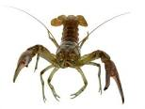

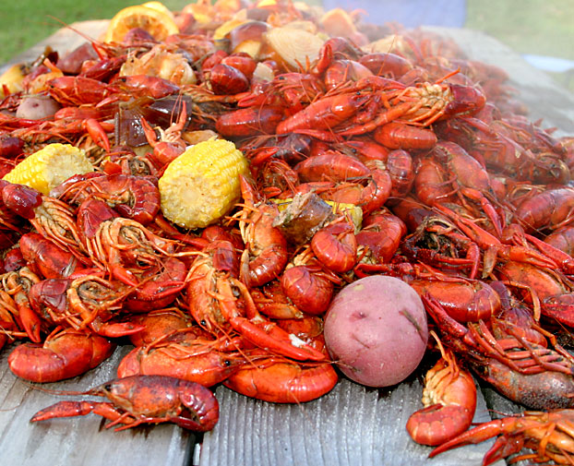
Introduction

Slide 3
Crayfish
Crayfish are small, freshwater arthropods that resemble lobsters.
They are usually brownish-green in color, but some species may be white, pink, or even blue.
Freshwater crayfish are divided into two family groups.
  Parastacidae in the southern hemisphere and
  Astacidae in the northern.

Slide 4
Crayfish
Crayfish can be found in a variety of freshwater environments throughout the world.
Found in temperate waters such as ponds and streams, they spend the day hiding under rocks and other objects for protection.
They are scavengers, and so at night they come out to feed on decaying plant matter, insect larvae, small fish, and worms.

Slide 5
Crayfish
Freshwater crayfish vary in size, depending upon the species.
Under good conditions commercial crayfish will grow about 100 grams per year before they are shipped out.
One species of Australian crayfish, however, can reach 200 kilograms.

Slide 6
Species
Among the 300 or so species, only four appear to have been used in some form of aquaculture.
The most important is the red crayfish (Procambarus clarkii-Family Cambaridae).
Signal crayfish (Pacifastacus leniusculus-Family Astacidae).
The white river crayfish P. acutus and the paper shell crayfish, Oreonectes immunis.

Slide 7
Growth
Crayfish, due to the molting process, grow at a stepped exponential rate.
After each molt the crayfish grows rapidly in size until the shell hardens.
The crayfish then pumps the body cavity full of water to enlarge the shell. This happens after molting, but while the new shell is still soft.
Normally the shell hardens within 2 days after molting. During the molting process, the redclaw stores calcium taken from the old shell in 2 gastroliths, or calcium buds, within the stomach.

Slide 8
Breeding
Most species breed only once or twice per year.
The eggs are laid and fertilized within the curled tail of the female crayfish.
The eggs are attached to the pleopods by specialized cement glands located on the tail of the female crayfish.
Most species breed only once or twice a year, female redclaw are capable of spawning up to 6 times per year.

Slide 9
Crayfish Aquaculture
Cherax quadricarinatus, which is native to the southern hemisphere, is healthier to eat than most traditional seafood.
Redclaw meat is low in fat, cholesterol, and salt. Their ability to reach 500 grams, go long periods of time without water, and go without oxygen for up to six hours, make them very profitable to raise and easy to transport.

Slide 10
Crayfish Aquaculture
The redclaw get their name from the red patches on the claws of the males, females however, have lighter, blue-colored claws
By rearing in warm water at 13-16C, the hatchlings grow to a length of 3-4 cm in less than half a year.
Food used is a mixture of fresh fish, liver etc.
The main cause of mortality in culture tanks is canibalsim of the newly moulted soft animals by the hard shelled one.

Slide 11
Pond Culture Methods
Procambarus clarkii is farmed in rice fields as a rotation crop or on a continuous basis in ordinary ponds.
For growing crayfish the levees of rice field are raised to about 50 cm. the recommended size of pond is about 8 ha for easy management.
Ponds are similar to finfish but their levees need not be higher than 50-75 cm.

Slide 12
Contd..
Depending on the environmental conditions, it takes 3-9 months and a minimum of eleven moults for a crayfish to mature.
Brood animals are stocked from April to June @ 20-65kg/ha. After the pond has been filled to a depth of at least 30cm.
A sex ratio of 1:1 is maintained.
After about two weeks the water is slowly drained which may take another two weeks to complete.

Slide 13
Contd..
Mating may take place during this period or sometimes even before stocking.
The male transfers sperm to a seminal receptacle between the females walking legs, where they remain viable for up to 6 months.
Eggs are extruded from oviducts and are fertilized by the sperm
The no. of eggs varies with the size of the animal and usually ranges between 100 eggs for a 7.5-8.5 cm and 600-700 for about 12.5cm length.

Slide 14
Feeding
Crayfish are omnivorous, but the bulk of their diet consists of microbially enriched detritus.
Vascular plants and epiphytic growths also form highly relished food items.
Animal matter such as worms, insects larvae, molluscs and zooplankton, are specially important food for juvenile crayfish.

Slide 15
Contd..
Many farmers depend on natural vegetation, including grasses and sedges.
The decomposing straw covered with microorganisms, including fungi and bacteria, forms a greater source of nutrients than the green rice plants on which the crayfish feed.
By using additional substrates, such as hay, it has been possible to prevent this and continue the detrital food chain, obtaining yields of upto 4000 kg/ha in stagnant ponds.

Slide 16
Contd…
Since trapping is labour intensive and not too efficient several improved harvesting techniques have been developed, such as crayfish combine and electro-trawls.
Most of the crayfish harvested are sold alive but about 30 percent are processed. They are killed by immersion in boiling water and then the tails are hand peeled for sale in fresh state.

Slide 17
Contd..
Harvesting is usually done with baited wire mesh traps or with lift nets from boats.
Two types of traps are used: a pillow trap, which has one or more funnel openings and is layyed submerged on the pond bottom and the stand –up trap which has two or more funnels at the bottom, with top open and reach surface of water.

Slide 18
Crab Culture

Slide 19


Introduction

Slide 20
Introduction
Crabs are decapod crustaceans
Culturing crabs (Family-Brachyura) has received attention in some countries b/c of high market demand and decreasing availability.
Intensive culture exhibits pronounced cannibalism problem during larval and adult stages.
A more profitable operation is the production of soft-shell crabs popularly known as “shedding crabs” on a commercial scale.

Slide 21
Contd..
Pre-moult blue crabs (Callinectes sapidus) captured from wild stocks are sold as soft shell crabs, fetch higher price.
Wild-caught peeler crabs (premoult crabs) which can be distinguished by colour changes associated with the formation of the new shell, are held for shedding in either floating box or on land based tables.

Slide 22
Culture of Scylla serrata
Only commercial –scale culture of crabs - serrated crab or mud crab Scylla serrata in some Asian countries.
In most coastal ponds and impoundments in Asia they are considered as subsidiary crop.
The young enter with the tidal water and grow their for a period of 6 months, to reach market size.
Mating and spawning take place in ponds, but the embryonic development and hatching appear to be retarded by low salinity.

Slide 23
Contd..
Scylla serrata is reported to spawn throughout the year, with peak from May-September.
According to Ong (1966) attain sexual maturity in about 11 months old.
Pair formation can be observed a few days before the pre-copulatory moult, and a few hours after the moulting mating occurs.
The spermatophores deposited in the spermatheca of the female remain viable for months.

Slide 24
Contd..
The time of actual spawning of the eggs varies, but three spawns in a period of 5 months have been observed.
About 2 million eggs may be found attached to the pleopods of the females, but half of them fail to attach to the setae.
The larvae hatch as planktonic zoae and after passing through a number of zoae stages and a megalopa stage , they metamorphose into juveniles which take on a benthic life.

Slide 25
Contd..
Brine shrimp nauplies have been used as larval food.
In ponds they feed on natural feed such as algae, crustaceans and other animal matter.
Some farmers feed them with trash fish @ 5-7% of their body weight.
Before moulting the crabs buries itself in the mud or in holes until its shell becomes hard.
Juveniles reach a harvesting size of 11-14 cm carapace width in about 6 months.
Selective harvesting is carried out with traps.

Slide 26
Contd..
For polyculture in brackish water ponds with milkfish, shrimp or sea weeds, larger ponds 0.5-2.0 ha are used, but oblique fences of bamboo or plastic have to be erected on the dikes to prevent escape.
Males and females juveniles have been stocked @ of 10,000/ha and are fed with same types of food as in monoculture.
Adequate feeding is reported to reduce cannibalism.
The crabs reach marketable size in about 6 months with a survival rate of 50-70 per cent.

