Slide 1
Insulin and Diabetes Mellitus
Dr. M. Shahzad
Dept. of Physiology
m.shahzad@uvas.edu.pk

Slide 2
Introduction:
Insuline is produced by Beta cells of Islets of Lengerhans.
Islets of lengerhans is one of the major tissue of Pancreas so Before describing Insuline ,
The introduction of Pancreas is vital to understand Insuline.

Slide 3
PANCREAS
The pancreas is a structure (an organ) that lies towards the back of the abdomen near the liver and the spleen and opens into the small intestine.
Gland with both exocrine and endocrine functions.
6-10 inch in length
1- ½ inch in width
70 gram in weight

Slide 4
Physiological anatomy of endocrine pancreas
Endocrine pancreas is a ductless gland which secrete their products into the blood stream.
It consist of groups of cells known as Islets of Langerhans.
The human pancreas has 1 to 2 millions islets of langerhans, each only about 0.3 millimeter in diameter.

Slide 5
Islets of langerhans makeup about 1 to 2% of the total pancreatic mass.
The islets contain four types of cells.
Alpha
Beta
Delta
F cells

Slide 6
Hormones of endocrine pancreas
Type of cell | Location | Hormones
Beta (60%) | central islets | insulin
Alpha(25%) | Outer rim of islets | glucagon
Delta (10%) | intermixed | somatostatin
F cell (1%) |  | pancreatic polypeptides
Remaining 4% consist of nerves, connected tissue and blood vessel.

Slide 7
INTRODUCTION
Insulin secreted by pancreatic beta cells in response to elevated blood glucose levels.
Increase transport of glucose to muscle, liver and adipose tissues.
The only hormone capable of lowering blood glucose level.

Slide 8
INSULIN STRUCTURE
Insulin is a small protein composed of two amino acid chains A and B.
A chain consist of 21 amino acids and B chain consist of 30 amino acids.
A and B chains are linked together by two disulfide bonds and additional disulfide with A chain.
Human insulin has a molecular weight 5800 D.

Slide 9
Action of Insulin on Various Tissues
Liver | Muscle | Adipose
↓ glucose production | ↑ Glucose transport | ↑ glucose transport
↑ glycolysis | ↑ glycolysis | ↑ lipogenesis& lipoprotein lipase activity
↑ TG synthesis | ↑ glycogen deposition | ↓ intracellular lipolysis
↑ Protein synthesis | ↑ protein synthesis

Slide 10
Factors and Conditions That Increase or Decrease
Insulin Secretion
Increase Insulin Secretion Decrease Insulin Secretion
• Increased blood glucose • Decreased blood glucose
• Increased blood free fatty acids • Fasting
• Increased blood amino acids • Somatostatin
• Gastrointestinal hormones • a-Adrenergic activity
(gastrin, cholecystokinin, secretin, • Leptin
gastric inhibitory peptide)
• Glucagon, growth hormone,
cortisol
• Parasympathetic stimulation;
acetylcholine
• b-Adrenergic stimulation
• Insulin resistance; obesity
• Sulfonylurea drugs

Slide 11
Diabetes Mellitus
It may be defined as a syndrome characterized by hyperglycemia due to an absolute or relative lack of insulin or insulin resistance.

Slide 12
Classification
Diabetes mellitus has two major variants differing in the capacity for pancreatic insulin secretion.
Type1 diabetes
Type 2 diabetes.

Slide 13
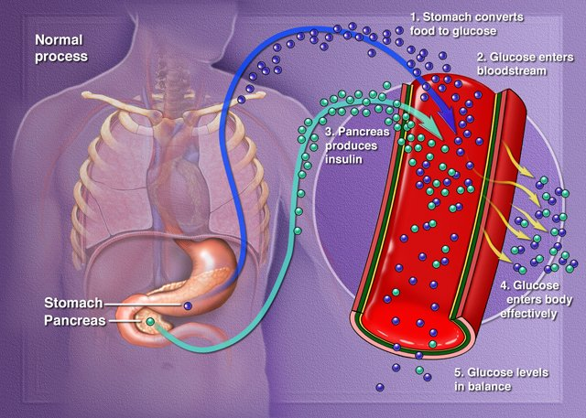
Glucose Control

Slide 14
Type I Diabetes
Low or absent endogenous insulin
Dependent on exogenous insulin for life
Onset generally < 30 years

Slide 15
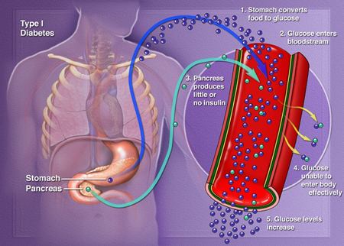
DM Type 1

Slide 16
Type II Diabetes
Insulin levels may be normal, elevated or depressed
  Characterized by insulin resistance,
  diminished tissue sensitivity to insulin,
  and impaired beta cell function (delayed or inadequate insulin release)
Often occurs >40 years
Notes:
Blood sugar levels are dependent upon glucose uptake after meals and hepatic release of glucose between meals. The sugar released from the liver comes either from stored glycogen or production of glucose from lactate and amino acids. This production of glucose is largely responsible for stabilization of postprandial blood sugar levels. The hyperglycemia noted in type 2 diabetes partially results from lack of control over hepatic glucose formation due to resistance to insulin. It has recently become clear that part of this insulin effect occurs indirectly through insulin-sensitive receptors in the brain (more precisely, in the hypothalamus).

Slide 17
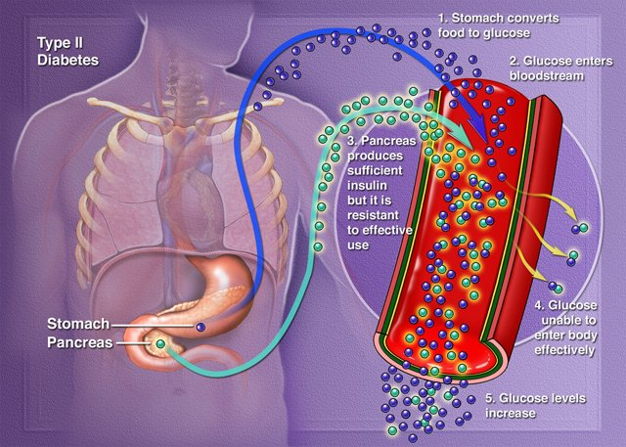
DM Type 2

Slide 18
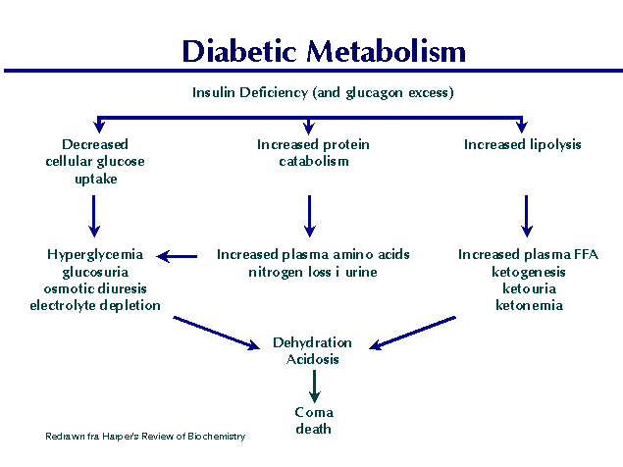
Notes:
Note that this figure applies both to uncontrolled diabetes type I and severe uncontrolled diabetes type II

Slide 19
Thank You

