Slide 1
Cerebrospinal Fluid(CSF)
Dr . M. Shahzad
Dept.of Physiology

Slide 2
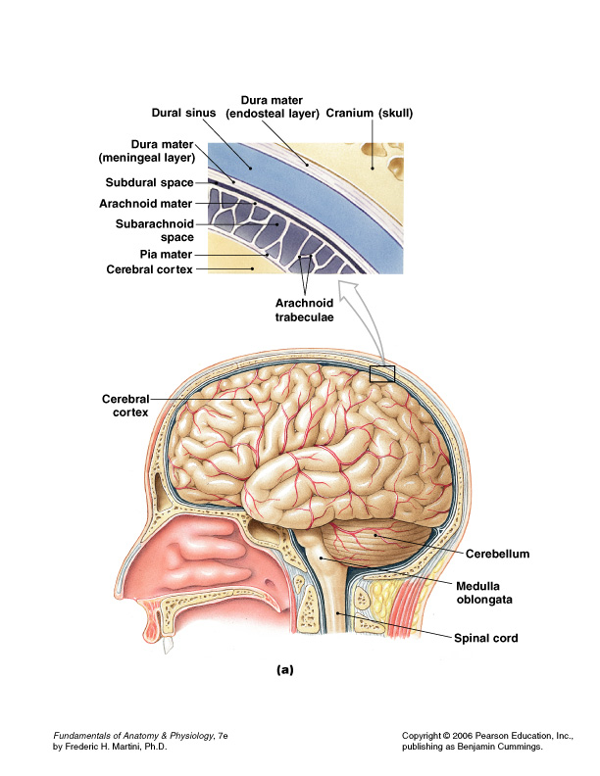
Protection of CNS
Scalp and skin
Skull and vertebral column
Meninges

Slide 3
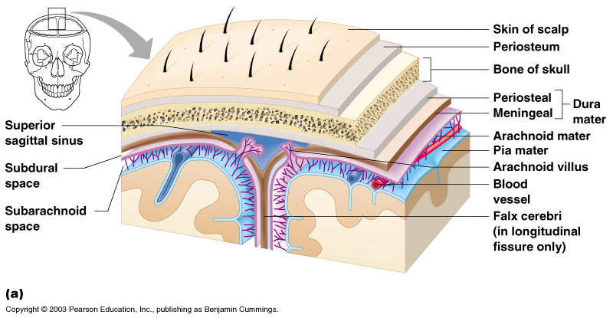
Protection of CNS
Cerebrospinal fluid
Blood brain barrier

Slide 4
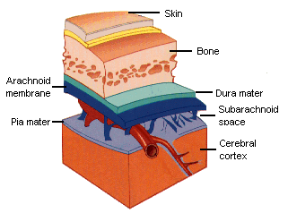
Meninges
Dura mater
  Double-layered external covering
    Periosteum – attached to surface of the skull
    Meningeal layer – outer covering of the brain
  Folds inward in several areas
Arachnoid layer
  Middle layer
  Web-like
Pia mater
  Internal layer
  Clings to the surface of the brain

Slide 5
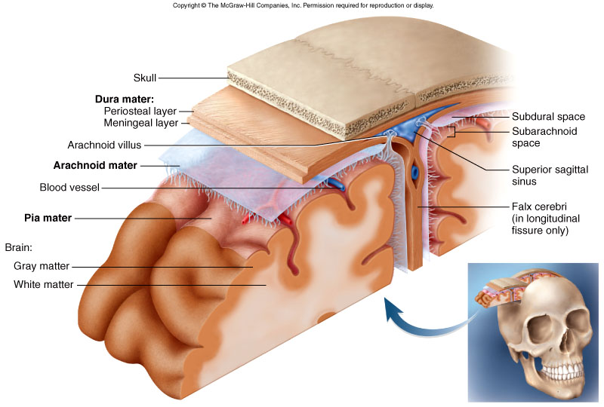

Slide 6
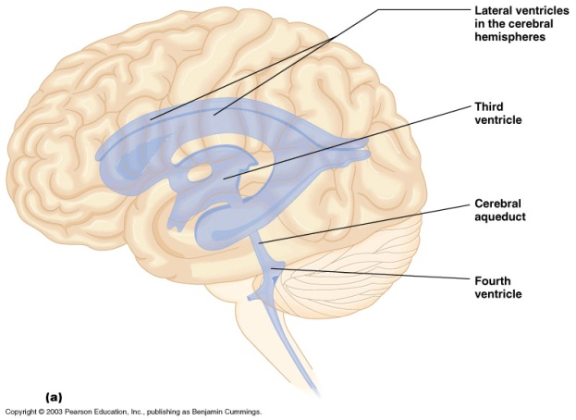
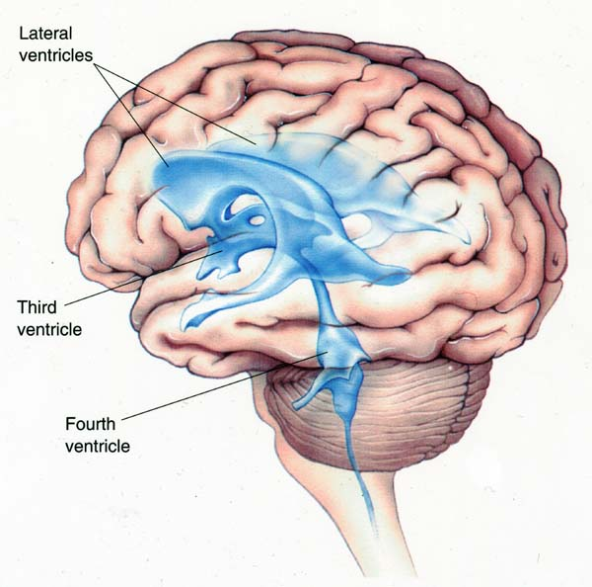
Location of CSF
Two lateral ventricles
Third ventricle
Fourth ventricle
Spinal cord central canal
Subarachnoid space
Continuous with extracellular fluid of brain parenchyma

Slide 7
Formation of CSF
Choroid plexuses of lateral, third and fourth ventricles
Ependymal lining of ventricular system
A choroid plexus consists of a combination of specialized epednymal cells and permeable capillaries for the production of CSF.

Slide 8
Formation of CSF
Cells are believed to actively secrete Na⁺ into the ventricular system in exchange for K⁺. Sodium ions electrically attract Cl⁻ and osmotically draw water from the blood vascular system to constitute the CSF.

Slide 9
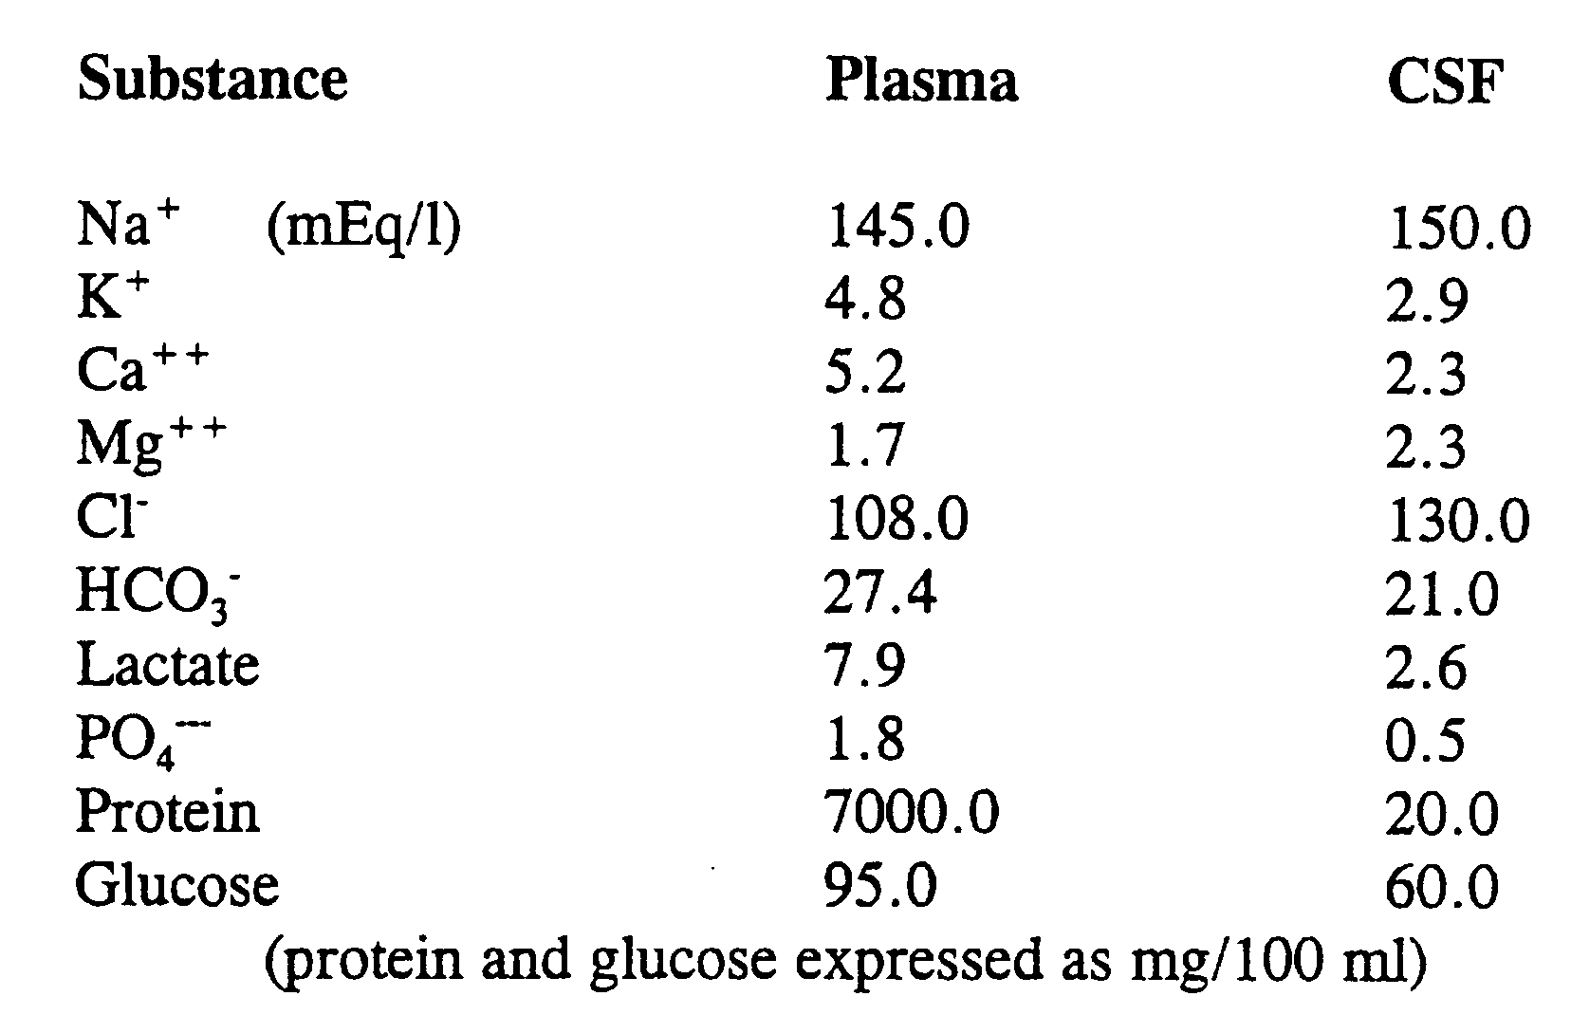
Composition of CSF

Slide 10
Properties of the CSF
CSF is secreted continuously at a rate of about 0.5 ml per minute, i.e. 720 ml per day.
The volume remains fairly constant at about 120 ml, which means that absorption keeps pace with secretion.
Specific gravity of 1.005, consisting of:
Water
Mineral salts
Glucose
Plasma proteins: small amounts of albumin and globulin
Creatinine and small amount of urea
A few leukocytes

Slide 11
Functions of cerebrospinal fluid
It maintains a uniform pressure around these delicate structures.
It acts as a cushion and shock absorber between the brain and the cranial bones.
It keeps the brain and spinal cord moist and there may be interchange of substances between CSF and nerve cells, such as nutrients and waste products.

Slide 12
Circulation of CSF
Due to pulsation of blood in choroid plexus
Due to pulsation of ependymal cells
Lateral ventricles interventricular foramen of Monroe third ventricle
mesencephalic aqueduct (aqueduct of Sylvius) fourth ventricle spinal cord central canal; also, out the lateral apertures to the subarachnoid space to the venous system

Slide 13
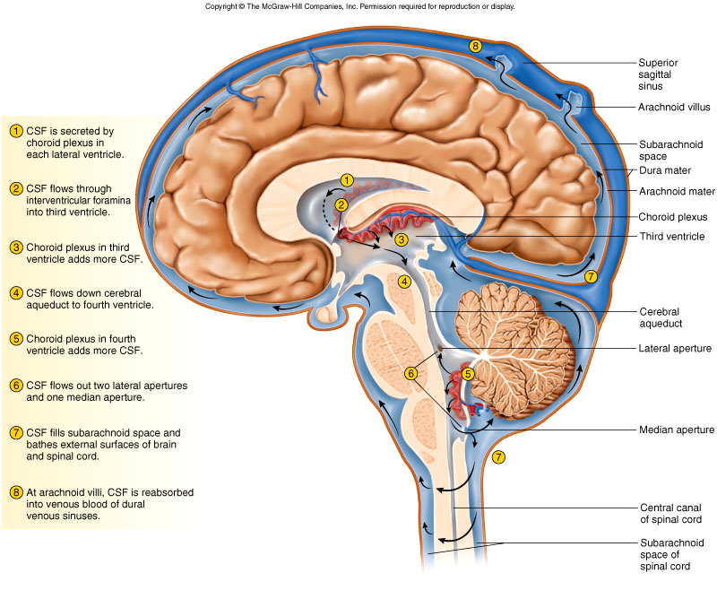
CSF Flow Pattern

Slide 14
Thanks

